Slide 1


Management Practices in Europe, the US and Emerging Markets
Nick Bloom (Stanford Economics and GSB)
John Van Reenen (LSE and Stanford GSB)
Lecture 7: Management in schools & public sector

Slide 2
Want to look at management practices in schools and the rest of the public sector
Management in schools
Promotion in the Military (New Atlantic)
Exit in Schools (Rubber Room Case)
2
Notes:
2

Slide 3

We interviewed around 800 high-schools
Using same approach as in manufacturing and hospitals
  Sampled high-schools (those with 15 year old kids)
  Targeted principals (head-teachers)
  45 minute double-blind telephone interview
Asked questions on:
  Monitoring
  Targets
  Incentives

Slide 4
Management scores strongly correlated with pupils exam performance
Student performance (z-score)
Management score
Notes: Graph based on 354 observations with available school performance information (Canada=77; UK=85; US=120; Sweden=72). Performance data are zscored within country (US 2009 math exam pass rate from High School Exit Exams/ End-of-Course exams, UK 2009 average uncapped GCSE score, CA 2009 Fraser Institute calculated ratings from school reports, and SW 2009 9th grade GPA).
4
Notes:
4
LON-AAA123-20101025-
4
Performance measures are available for all regions covered by our survey in Sweden and in the UK. In Canada and the US, states/regions where performance measures were available are the following: Alabama, Arizona, Arkansas, California, Colorado, Florida, Georgia, Illinois, Louisiana, Massachusetts, Minnesota, New Jersey, New York, North Carolina, Ohio, Oklahoma, Oregon, Pennsylvania, Texas, Virginia, Washington, Wisconsin, Wyoming (US), and Alberta, British Columbia, Ontario (Canada).

Slide 5
School management varies across countries
Note: Averages taken across all schools within each country. 988 schools. School controls include: number of pupils, pupil-teacher ratio, age, ownership, type. Noise controls include: interviewee tenure in post, gender, seniority; interview duration, reliability, time, day of the week; analyst dummies
Notes:
Once controls are included there are 4 different sets (wonder if us and canada should be grouped)

Slide 6
School management practices show a large spread
Schools
Hospitals
Retail
US
US
1
1
.5
.5
0
0
Canada
Canada
1
1
Fraction of Organizations
.5
.5
0
0
Europe
UK
1
1
.5
.5
0
0
1
2
3
4
5
1
2
3
4
5
Firm management scores, from 1 (worst practice) to 5 (best practice)
Note: Bars are the histogram of the actual density. The line is the smoothed US density for comparison.
Notes:
Note: In schools country location accounts for 34% of the overall difference in management scores, showing higher variation between countries in Education relative to Healthcare and Manufacturing (18% and 21%, respectively). Variation across schools within the same country, on the other hand, accounts for 44% of the difference in management scores and is relatively lower than variation within hospitals and manufacturing firms in the same country (80% and 63%, respectively). Variation across regions within the same country accounts for only 14% of the overall difference in management scores

Slide 7
Key factors associated with good management similar to other sectors
Size
Competition
Ownership

Slide 8
Size: There is a strong relationship between school size and management practice
0
Management practice score
Position in the within country size distribution
8
8
Notes:
8
LON-AAA123-20101025-
Note: the relationship between size and management is significant in all countries, except Sweden. I

Slide 9
Competition: correlated with good for management
0
Management practice score
Number of competing schools within a 30min drive
9
Notes:
9
LON-AAA123-20101025-
None (N=121; ) 1 (N=97); 2-4 (N=277); 5+ (N=489) . Note that effect is reduced but still significant once regional dummies, school, interview and local controls are included. Hoxby argues effect likely to be underestimated as new schools typically arise as a consequence of parent dissatisfaction. Effect is stronger for: public schools; monitoring and lean (data driven instructional methods); Sweden. Need to work on better competition measures.

Slide 10
Government owned = poor management, particularly in incentives (hiring, firing, pay and promotions)
Schools
Manufacturing
Hospitals
Monitoring management
Targets
management
Incentives
management
-0.2
-0.1
0
-0.3
-0.2
-0.1
0
Management score gap between Government and privately owned schools
Notes:
Note that in schools people management is THE source of difference between public and private, much more so than in other sectors. Difference is also much larger in absolute terms. Note that difference between public and private schools differers across countries

Slide 11
Want to look at management practices in schools and the rest of the public sector
Management in schools
Promotion in the Military (New Atlantic)
Exit in Schools (Rubber Room Case)
11
Notes:
11

Slide 12
Want to look at management practices in schools and the rest of the public sector
Management in schools
Promotion in the Military (New Atlantic)
Exit in Schools (Rubber Room Case)
12
Notes:
12

Slide 13


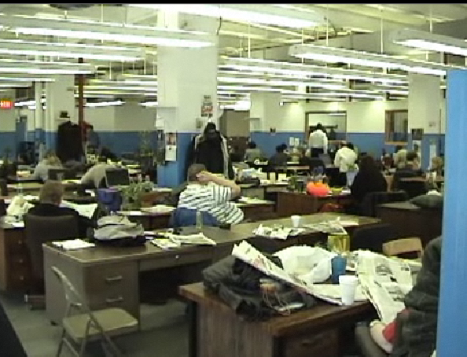
How do you think management practices in New York Schools will impact pupil performance?
Notes:
Incentives and selection

Slide 14
How would you change the practices in the New York school district?
Notes:
Hard -

Slide 15
Can you provide examples from your own experiences of management practices in schools in other countries?

Slide 16
MY FAVOURITE QUOTES:
A firing strategy in US schools
Interviewer: How difficult is it to fire your tenured staff?
Principal: Urghhh I call it war games…Do I bomb? Do I move the troops? Maybe an ambush attack. I play my strategy!
Standardization in UK schools
Interviewer: How standardized are your instructional planning processes?
Principal: Very standardized! For example, I tell all my World History teachers that they must kill Napoleon before Christmas!
Notes:
16
16

