Slide 1

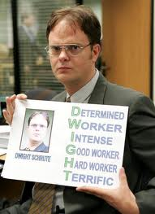
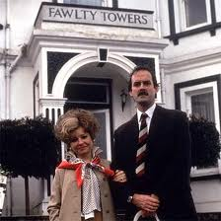
Management Practices in Europe, the US and Emerging Markets
Nick Bloom (Stanford Economics and GSB)
John Van Reenen (LSE and Stanford GSB)
Lecture 6: Management in hospitals

Slide 2
To date focused on manufacturing, want to turn now to hospitals
Management in hospitals
Virginia Mason Case
2
Notes:
2

Slide 3




Management Matters in Healthcare

Slide 4
Big picture question is does management matter in healthcare – can better management save lives?
Literature on management generally poor – case studies
As a result very mixed views:
Some believe management drives everything (believers)
Others believe it doesn’t matter (skeptics)
We wanted large samples of international data to investigate

Slide 5
Partners
Academics
Nick Bloom (Stanford)
Christos Genakos (Cambridge)
Rebecca Homkes (LSE)
Renata Lemos (Cambridge)
Raffaella Sadun (Harvard Business School)
Daniela Scur (Toronto)
John Van Reenen (LSE)
Consultants
Dennis Layton (McKinsey & Co)
Stephen Dorgan (McKinsey & Co)
John Dowdy (McKinsey & Co)

Slide 6
Agenda
1
Measuring management practices in healthcare
2
Describing management across hospitals
3
“Drivers” of management practices
4
Implications for policy makers and others

Slide 7
THE MANAGEMENT SURVEY METHODOLOGY
1) Developing management questions
  21 practice scorecard: “lean” operations, monitoring, targets & incentives
  Interviewed managers & doctors in orthopaedics & cardiology for ~1 hour
2) Getting hospitals to participate in the interview
  Performance indicators from external sources (not interview)
  Endorsement letters from Department of Health etc.
  Run by MBA and MD students over summer 2009
3) Obtaining unbiased responses (“Double-blind”)
  Interviewers do not know the hospital’s performance
  Interviewees are not informed (in advance) they are scored
Notes:
Interviewees non-UK so not prejudiced one way or another (Greg, Pedro, Kanon, May)

Slide 8
Q1 LEAN OPERATIONS – layout of patient flow
  Can you briefly describe the patient journey for a typical episode?
  How closely located are the wards, theatres and consumables?
  Has the patient flow and the layout of the hospital changed in recent years
Score | (1): Layout of hospital and organisation of workplace is not conducive to patient flow, e.g., ward is on different level from theatre, or consumables are often not available in the right place at the right time | (3): Layout of hospital has been thought through and optimised as far as possible; but workplace organisation is not regularly challenged (and changed) | (5): Hospital layout has been configured to optimize patient flow; workplace organization is challenged regularly and changed when needed
Notes:
8
Examples: “Lean” introduction in Virginia Mason Hospital (VMPS https://www.virginiamason.org/body.cfm?id=5154) explicitly based on Toyota principles. (i) In Oncology ward found that patients moved around different wards unnecessarily. Floyd & Delores Jones Cancer Institute at Virginia Mason redesigned with a laboratory and pharmacy inside, eliminating the need for patients to travel throughout the hospital for chemotherapy. For one patient, this reduced the length of a chemotherapy visit from 10 hours to two and saved about 500 feet of walking at each visit. (ii) Making sure supplies of nursing equipment all in place. Example in NHS hospitals of only one night nurse. Needed to change patient sheets and all sheets where located 2 floors away. When nurse was away, another patient had an attack and died. Problem logged but not dealt with

Slide 9
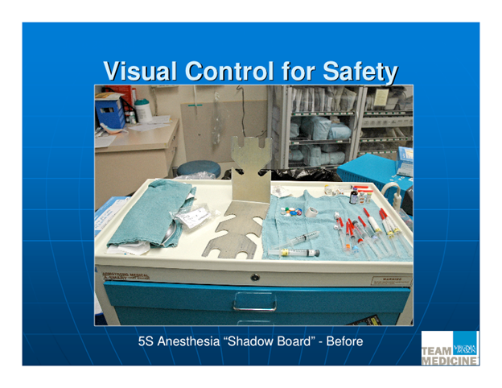
TYPICAL PROCESS IMPROVEMENT(BEFORE)

Slide 10
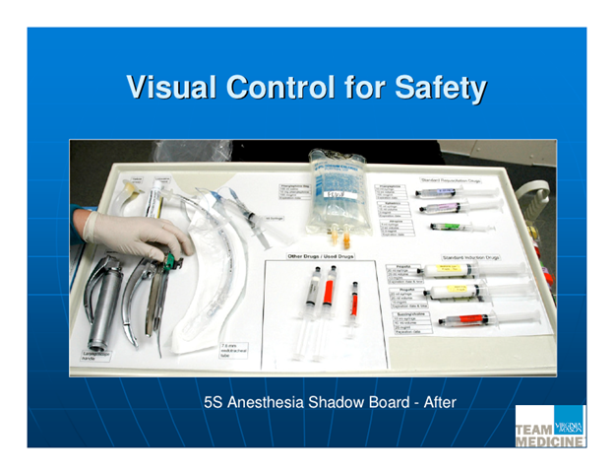
TYPICAL PROCESS IMPROVEMENT (AFTER)
Notes:
standardization & cleaning of anesthesiologist’s instrument tray in time – if not done means delays to starts of operations. Standardization also means greater safety: anesthesiologists like to use different equipment so when there is a last minute change to a different theatre this can confuse them and compromise safety.

Slide 11
Q5 MONITORING – Performance review
How do you review your department’s performance? Tell me about a recent meeting. Who is involved in these meetings? Who gets to see the results. What is the follow-up plan? Can you tell me about the recent follow-up plan?
Score | (1): Performance is reviewed infrequently or in an un-meaningful way e.g. only success or failure is noted | (3): Performance is reviewed periodically with both successes and failures identified. Results are communicated to senior staff. No clear follow up plan is adopted. | (5): Performance is continually reviewed, based on the indicators tracked. All aspects are followed up to ensure continuous improvement. Results are communicated to all staff.

Slide 12
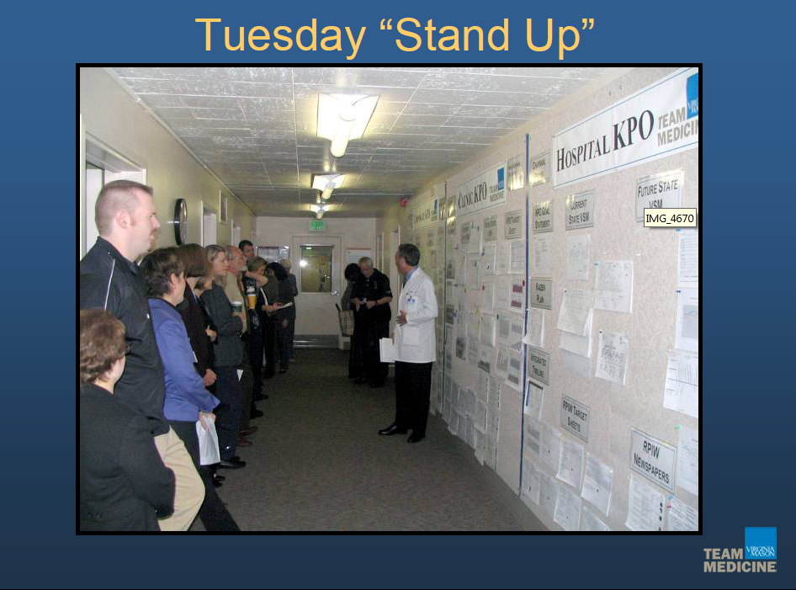
REGULAR PERFORMANCE MONITORING

Slide 13
Q15 INCENTIVES - Removing poor performers
  If you had a nurse who could not do her job adequately, what would you do? Could you give me a recent example?
  How long would underperformance be tolerated?
  Do some individuals always just manage to avoid being re-trained/fired?
Score | (1): Poor performers are rarely removed from their positions | (3) Suspected poor performers stay in a position for a few years before action is taken | (5): We move poor performers out of the hospital/department or to less critical roles as soon as a weakness is identified
Notes:
13
How do the different staff groups get involved in this process? Can you give examples?

Slide 14
Agenda
1
An overview
2
Measuring management practices in healthcare
3
Describing management across hospitals
4
“Drivers” of management practices
5
Implications for policy makers and others

Slide 15

We interviewed almost 1,200 hospitals across 7 countries
^{l}
Number of interviews
U.S.
U.K.
Canada
Italy
France
Germany
Sweden
Notes:
15
1194 hospitals in public and private sector (184 in UK )
– Response rates uncorrelated with performance
Collect data on many “noise” controls:
– Interviewer fixed effects
– Interview characteristics (e.g. duration, day, time)
– Interviewee characteristics (e.g. tenure, job)
Match to performance and detailed demographics data

Slide 16
We found good management is strongly correlated with better clinical and financial performance
A one point increase in management practice is associated with:
UK Hospitals
  Health: 6.5% reduction in risk adjusted 30 days AMI mortality rates
  Financial: 33% increase in income per bed
  Patient: 20% increase in above average patients satisfaction
US Hospitals
  Health: 7% reduction in risk adjusted 30 days AMI mortality rates
  Financial: 14% increase in EBITDA per bed
  Patient: 0.8 increase in % people would recommend the hospital
16
Notes:
16
LON-AAA123-20101025-
16

Slide 17
Hospital Management Practices Vary Across Countries
Hospitals
US
UK
Germany
Sweden
Canada
Italy
France
2.2
2.4
2.6
2.8
3.0
3.2
Note: Averages taken across all organizations within each country. 1,183 hospitals

Slide 18
Hospitals Management Practices Show A Large Spread
Hospitals
US
1
.5
0
Canada
1
Fraction of Hospitals
.5
0
Europe
1
.5
0
1
2
3
4
5
Management scores, from 1 (worst practice) to 5 (best practice)
Note: Bars are the histogram of the actual density. The line is the smoothed (kernel) of the US density for comparison.

Slide 19
Agenda
1
An overview
2
Measuring management practices in healthcare
3
Describing management across hospitals
4
“Drivers” of management practices
5
Implications for policy makers and others

Slide 20
Found many of the same factors from Manufacturing
Ownership – private hospitals much better (not for profit in the middle) on pay, promotions, hiring and firing
Size – larger hospitals were better managed
Competition - from other hospitals improves management
  Correlations cross-sectional
  Evidence from politically driven UK hospitals closures

Slide 21
More hospitals in politically marginal districts
3.8
3.61
3.6
3.47
Number of Hospitals per Million Population
3.4
3.33
3.35
3.27
3.2
3.20
3
<-10
-10<x<-5
-5<x<0
0<x<5
5<x<10
>10
Governing Party’s (Labour) winning percent margin in 1997

Slide 22

Because of people like Dr. Richard Taylor
Politically sensitive: e.g. Dr. Richard Taylor, Kidderminster 2001
  “Defeated a sitting government minister (David Lock, Labour) in 2001 to take Wyre Forest after campaigning on a single issue - saving the local Kidderminster Hospital which the government planned to downgrade” BBC News, 30/4/2010”
Notes:
What lies behind competition effect (i) yardstick competition?; (ii) labor markets; (iii) limited financial incentives; (iv) omitted variables [casemix, some underlying quality” of area such as quality of a teaching university]
22

Slide 23
Hospitals with more clinicians as managers (more hospital relevant skills measure) have better management
2
Management score relative to national mean
1.02
Bottom quartile
2nd quartile
3rd quartile
Top quartile
Proportion of managers with a clinical degree
Notes:
23
LON-AAA123-20101025-
The average management score in deviation from country means.
Italy is excluded as it is a legal requirement that all general managers have clinical degrees

Slide 24
There is wide variation in the prevalence of clinically trained managers by country
Percentage of managers with a clinical degree¹
Sweden
US
Canada
Germany
France
UK
1 Italy excluded as it is a legal requirement that all general managers have clinical degrees
24
Notes:
24
LON-AAA123-20101025-

Slide 25
MY FAVOURITE QUOTES:
Don’t get sick in Britain (1/2)
Interviewer : “Do staff sometimes end up doing the wrong sort of work for their skills?
NHS Manager: “You mean like doctors doing nurses jobs, and nurses doing porter jobs? Yeah, all the time. Last week, we had to get the healthier patients to push around the beds for the sicker patients”

Slide 26
MY FAVOURITE QUOTES:
Don’t get sick in Britain (2/2)
Interviewer : “Do you offer acute care?”
Switchboard: “Yes ma’am we do”
Interviewer : “Do you have an orthopeadic department?”
Switchboard: “Yes ma’am we do”
Interviewer : “What about a cardiology department?”
Switchboard: “Yes ma’am”
Interviewer : “Great – can you connect me to the ortho department”
Switchboard?: “Sorry ma’am – I’m a patient here”

Slide 27
Wrap-up
Core management practices of monitoring, targets and incentives also important in healthcare
Wide dispersion of practices across hospitals
Key challenges for healthcare management:
  Widespread public ownership (unions etc.)
  Political interference
  Divisions between medics and managers

Slide 28
Management Matters in Healthcare

Slide 29
To date focused on manufacturing, want to turn now to hospitals
Management in hospitals
Virginia Mason Case
29
Notes:
29

Slide 30
What is Gary Kaplan trying to achieve at Virginia Mason?

Slide 31
How does the Toyota Production System fit into his strategy

Slide 32
Is Gary Kaplan’s approach transferrable to other hospitals?

