Slide 1

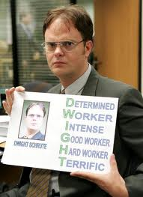
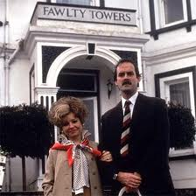
Management Practices in Europe, the US and Emerging Markets
Nick Bloom (Stanford Economics and GSB)
John Van Reenen (LSE and Stanford GSB)
Lecture 5: Power & Decentralization in Firms

Slide 2
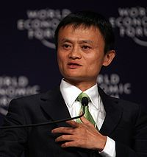
What is decentralization?
Alibaba Case
Decentralization & learning
Measuring real authority
Factors affecting decentralization

Slide 3
What is decentralization?
One aspect of firm organization - how power and decision making are distributed
Unlike basic management practices no typical “good” and “bad” – just different styles which tend to vary by country
Why should you care:
  Key in designing your business or advising others
  Changing over time, generating broader economic effects, like increased inequality and worker empowerment

Slide 4
Formal vs. Real Authority
Formal authority in the organization chart (“organogram”)
  E.g. Profit centers vs. cost/sales centers
Real authority
  How things actually get done. Power
  http://www.youtube.com/watch?v=5FRVvjGL2C0
Can be different across different types of decisions
  e.g. Investment, pricing, products

Slide 5
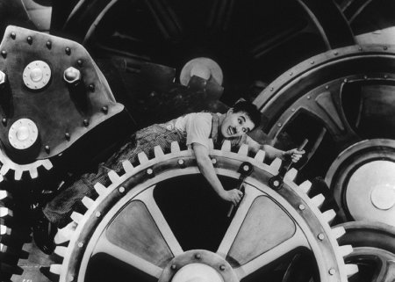
Real authority models: Centralized
http://www.youtube.com/watch?v=wBIov_CSqyI&feature=related

Slide 6
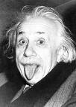
Real authority models: Decentralized
e.g. Universities

Slide 7
What is decentralization?
Alibaba Case
Decentralization & learning
Measuring real authority
Factors affecting decentralization

Slide 8
Questions on the Alibaba case
What does Alibaba do?

Slide 9
Questions on the Alibaba case
Is the current degree of competition/decentralization among the business units appropriate?

Slide 10
Questions on the Alibaba case
Do you think that Jack Ma should encourage more cooperation? If so, how?

Slide 11
Questions on the Alibaba case
Where should the new business initiatives (mobile platforms and financing small businesses) reside organizationally? At corporate or within the individual business units?

Slide 12
Questions on the Alibaba case
What does the Talent Myth tell us about the risks of decentralization?

Slide 13
What is decentralization?
Alibaba Case
Decentralization & learning
Measuring real authority
Factors affecting decentralization

Slide 14
Decentralization (into profit centers like Alibaba)
Learning Theory: CEO decentralizes when knowledge of local managers very important. Decentralize when:
  Firm is young (less experience to draw on)
  Firm uses more advanced technology
  Industries are more volatile & changing quickly (heterogeneous – harder to learn from others)
Evidence
  Consistent with Alibaba
  Acemoglu, Aghion, Lelarge, Van Reenen, Zilibotti (2007) look at 1,000s of French and British firms. Ran econometric models with many controls

Slide 15
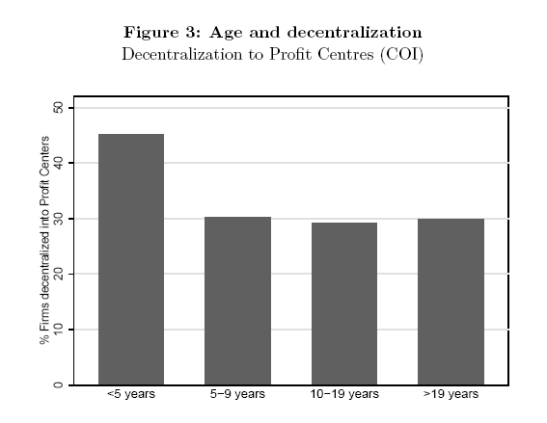
Younger firms are more decentralized
15

Slide 16
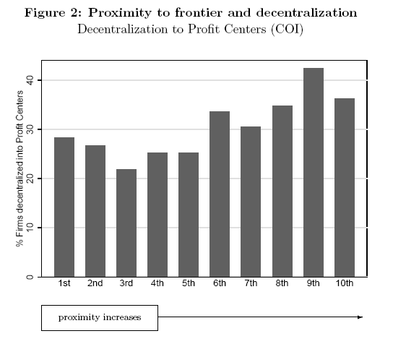
More technologically advanced firms more likely to be decentralized

Slide 17
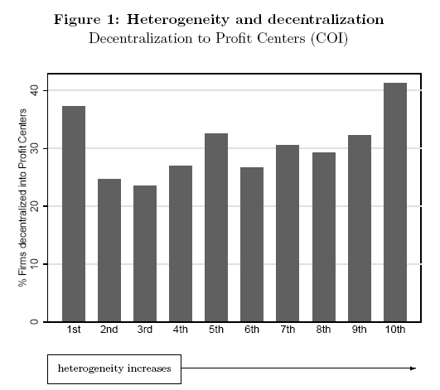
Firms in more volatile sectors (bigger variance of productivity shocks) are more likely to be decentralized

Slide 18
What is decentralization?
Alibaba Case
Decentralization & learning
Measuring real authority
Factors affecting decentralization

Slide 19
Example A:
Domestic Firm
2 Sites, Single Plant
Central HQ
(New York Site)
D, Decentralization
Plant
(Albany Site)

Slide 20


Example B:
US Domestic Firm
Multi-Site, Multi-Plants
Central HQ
(New York Site)
D1
D2
D3
Plant 1
(Buffalo Site)
Plant 2
(Albany Site)
Plant 3
(Scranton Site)

Slide 21
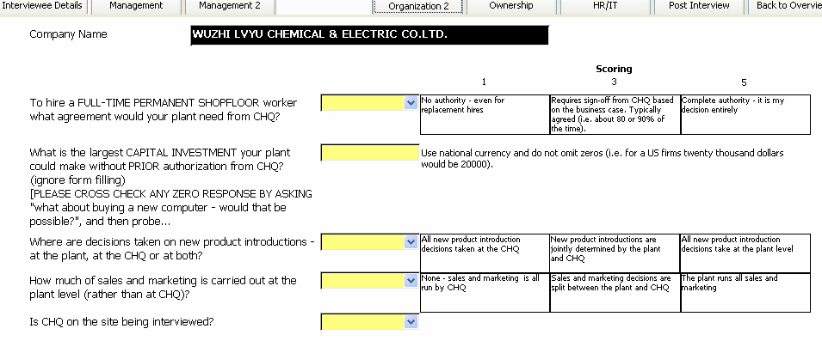
The Decentralization Survey Page

Slide 22
Our empirical decentralization measure
  Main measure averages the z-score (scores normalized to mean 0, standard-deviation 1) of each variable:
    Hiring senior employees (discrete, 1 to 5)
    Maximum Capital expenditure (continuous, in $)
    Introduction of new products (discrete, 1 to 5)
    Sales and marketing (discrete, 1 to 5)

Slide 23
Decentralization varies heavily across countries
Most centralized
Asia
Southern Europe
Least centralized
Scandinavian countries
Anglo-Saxon countries
Decentralization measure
Notes:
This is central graph in paper. Anglo-saxon/scandinavia vs asia and europe; ranking pretty independent of gdp pc or prod

Slide 24
What is decentralization?
Alibaba Case
Decentralization & learning
Measuring real authority
Factors affecting decentralization

Slide 25
Larger Firms: More or less decentralized?
100-200
200-500
500-1000
1000+
Number of employees in the firm

Slide 26
Larger Firms are more decentralized
100-200
200-500
500-1000
1000+
Number of employees in the firm

Slide 27
Firms with more skilled workers?
Under 20%
20%-40%
40%-60%
60%-80%
80%-100%
Proportion of employees with a college degree

Slide 28
Firms with more skilled workers are more decentralized (complements)
Under 20%
20%-40%
40%-60%
60%-80%
80%-100%
Proportion of employees with a college degree

Slide 29
Legal and Cultural Factors affecting Decentralization
Trust
  Alibaba’s key competitive advantage was building trust with customers.
  But trust more important generally?
  In high trust areas (e.g. Sweden, US) managers likely to be trusted to carry out more activities than low trust (e.g. Southern Italy, parts of India)
Rule of Law
  In strong rule of law areas (e.g. US) top management less worried about theft by middle management

Slide 30
Trust and decentralization
How to measure trust? World Value Survey (10,000s of individuals from different countries) asks question:
  “Generally speaking, would you say that most people can be trusted or that you can’t be too careful in dealing with people?”
Trust by region of the country defined as % of people
answering “yes” to first part of the trust question
Experiments show this question linked with trust/trusting behavior

Slide 31
Trust, rule of law and decentralization
Trust (region) | 1.196*** | 0.825*** | 0.732**
 | (0.429) | (0.290) | (0.298)
Rule of law (country) |  | 0.473***
 |  | (0.102)
Observations | 3549 | 3549 | 3549
Country dummies | no | no | yes
Other controls | no | no | yes
Notes: Other controls are SIC3 dummies, noise controls (interviewer dummies
Interviewee tenure and seniority, etc.), public listing, CEO onsite, plant size, competition

Slide 32
Also look at multinationals as another test of trust
Could worry about bias due to trust proxying for other country/regional variables
So look at affiliates of foreign multinationals and investigate whether trust in their home country also matters
Bilateral trust: (on average) how much do people in the multinational’s home country trust people in the country where the subsidiary is located (Eurobarometer Survey)

Slide 33
Decentralization and trust in multinational firms
Trust (region of location) |  | 0.563 | 0.446
 |  | (0.843) | (1.908)
Trust (country of origin) |  | 0.749*** | 0.152
 |  | (0.301) | (0.152)
Trust (bilateral from origin cty to location cty) |  |  | 1.809***
 |  |  | (0.768)
Full set of controls |  | Yes | Yes
Regional dummies |  | No | No
Country origin dummies |  | No | No
Clustering |  | Region | Origin country
Observations |  | 867 | 280

Slide 34
Does decentralization matter for economic performance?
Short run: generally depends on firms circumstances (e.g. country, industry and technology).
Long run: to be large you need some decentralization, so key for growth (Penrose 1959 and Chandler 1962)

Slide 35
Wrap-up
  Alibaba shows the benefits of decentralization, but also costs
    Initiative/incentives vs. co-ordination
  Complementarity of organization with strategy (people, pay) and circumstances (high growth China, volatile technology)
  Decentralization
    Varies a lot within and between countries
    Varies systematically technological, economic and cultural factors
    More general importance for economics growth

Slide 36
Back-up

Slide 37
Decentralization also varies across ownership types – with founder and government firms centralized
Decentralization measure
Notes:
37
This graph shows : a) cross country ranking coherent with similar measures of hierarchical organizations b) persistence over time c) striking given multi industry vs single firm comparison

Slide 38
Trust by country (means and regional spreads)
The graph shows median level of trust. The vertical bars denote minimum and maximum levels.

Slide 39
Decentralization also varies across firms
Decentralization measure (higher number is more decentralized)
Notes:
Note: Variation between countries by three digit SIC is 55%, 45% within country and industry

Slide 40
Are things really changing?
"Globalization and the arrival of the information economy have rapidly demolished all the old precepts. The management of global companies, which must innovate simultaneously and speed information through horizontal globe-spanning networks, has become a daunting challenge. Old, rigid hierarchies are out ...."
Business Week The 21st Century Corporation, cover story August 21-28, 2000.

Slide 41
Evidence is limited, but appears yes, firms are decentralizing
Delayering – Number of positions reporting to CEO
Source: Rajan and Wulf, 2006, 300+ large US corporations

Slide 42

External validation – decentralization over time
Only prior firm decentralization measure to cross-check against we are aware of is from Hofstede
  Surveyed c.100,000 IBM employees across 50 countries during the 1970s & 1980s
  Questions on management style (autocractic/paternalistic or consultative) and preferences for delegation
  Combined into Power Distance index (1-100), low means limited (preference for) delegation

Slide 43
‘Power distance’ measures from 1970s & 1980s matches our 2000s decentralization data quite well
Decentralization
Correlation= 0.80
Power distance
Notes:
This graph shows : a) cross country ranking coherent with similar measures of hierarchical organizations b) persistence over time c) striking given multi industry vs single firm comparison

Slide 44
Fiscal decentralization (whether Governments are centrally run) looks similar – so something cultural?
Firm Decentralization
Correlation= 0.83
Fiscal Decentralization
(Arzaghi and Henderson, 2005)
Notes:
44
This graph shows : a) cross country ranking coherent with similar measures of hierarchical organizations b) persistence over time c) striking given multi industry vs single firm comparison

Slide 45
ICT has a mixed impact on decentralization
Enterprise Resource Planning | 0.104* |  | 0.116**
Information technology | (0.054) |  | (0.054)
NETWORK |  | -0.098* | -0.110**
Communication technology |  | (0.053) | (0.053)
Computers/Employee | -0.041 | -0.021 | -0.031
 | (0.031) | (0.031) | (0.031)
Information technology (IT) increase decentralization
Communications technology (CT) decreaseas decentralization
Notes: Controls are SIC3 dummies, country dummies, noise controls (interviewer dummies Interviewee tenure and seniority, etc.), public listing, CEO onsite, plant size,
Notes:
In last column ERP assoc with a 11.5% of a s.d. more autonomy (Networks 11% less)

Slide 46
Example A:
Domestic Firm
2 Sites, Single Plant
Central HQ
(New York Site)
D, Decentralization
Plant
(Phoenix Site)

Slide 47
Example D
Japanese MNE
Global HQ
(Tokyo Site)
Do not observe D
French CHQ
(Paris Site)
Sweden CHQ
(Stockholm Site)
Observe D
Observe D
Plant 2
(Lyon Site)
Plant 1
(Lund Site)

