Slide 1
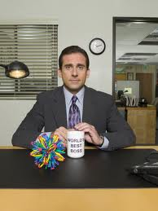
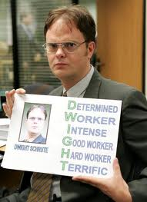
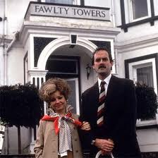
Management Practices in Europe, the US and Emerging Markets
Nick Bloom (Stanford Economics and GSB)
John Van Reenen (LSE and Stanford GSB)
Lecture 2: Management and firm Performance

Slide 2
Measuring management
Danaher
Monitoring management practices
Drivers of good management

Slide 3
The Survey Methodology
1) Developing management questions
  Scorecard for 18 monitoring, targets and incentives practices
  ≈45 minute phone interview of manufacturing plant managers
2) Obtaining unbiased comparable responses (“Double-blind”)
  Interviewers do not know the company’s performance
  Managers are not informed (in advance) they are scored
  Run from London, with same training and country rotation
3) Getting firms to participate in the interview
  Introduced as “Lean-manufacturing” interview, no financials
  Official Endorsement: Bundesbank, PBC, CII & RBI, etc.
  Run by 100+ MBAs (credible with business experience)
3
Notes:
3

Slide 4
Example question: “how is performance tracked?”
Score | (1): Measures tracked do not indicate directly if overall business objectives are being met. Certain processes aren’t tracked at all | (3): Most key performance indicators are tracked formally. Tracking is overseen by senior management | (5): Performance is continuously tracked and communicated, both formally and informally, to all staff using a range of visual management tools
4
Notes:
4

Slide 5
Management practices and performance
Productivity log(sales/employee)
Management score

Slide 6
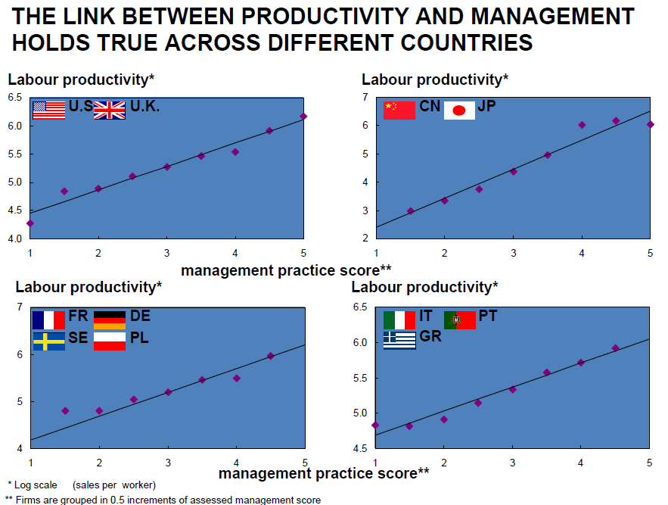

Slide 7
BETTER PERFORMANCE IS CORRELATED WITH BETTER MANAGEMENT
Dependent variable | Product -ivity | Profits (ROCE) | 5yr Sales growth | Exit
Estimation | OLS | OLS | OLS | Probit
Firm sample | All | All | Quoted | All
Management | 23.3*** | 1.952*** | 6.738*** | -26.2**
Firms | 2,927 | 2,927 | 2,927 | 3,161
Notes: OLS Regressions includes controls for country, industry, year, firm-size, firm-age, skills, “noise” & whether publicly listed.
Is this causal?
Notes:
Relationship is still there in time series, although much smaller (cf Black and Lynch)

Slide 8
Management practices across countries
Distinct groups
Average Country Management Score

Slide 9
Management practices across firms (US and India)
US, manufacturing, mean=3.33 (N=695)
Density
India, manufacturing, mean=2.69 (N=620)
Density
Firm level management score, manufacturing firms 100 to 5000 employees
9

Slide 10
Some firms seemed to be too truthful
Who rules the home in Ireland
Interviewer: “Would you mind if I asked how much your bonus is as a manager?”
Manager: “I don't even tell my wife how much my bonus is!”
Interviewer: “Frankly, that’s probably the right decision...”
Staff retention the American way
Manager: “I spend most of my time walking around cuddling and encouraging people - my staff tell me that I give great hugs”
The trusted Secretary
French secretary: “You want to talk to the plant manager? There are legal proceedings against him, so hurry up!!”
Notes:
10

Slide 11
Measuring management
Danaher
Monitoring management practices
Drivers of good management

Slide 12
Q1 Why has Danaher been successful as a multi-business conglomerate over the past two decades? What do you see as the core attributes of its corporate strategy that have allowed it to sustain superior performance during this period?
Operations
Corporate strategy

Slide 13
How easy or difficult is it for other companies to mimic or emulate what Danaher does? Why?

Slide 14
Are there any salient trade-offs that the DBS system creates for the organization?

Slide 15
What do you consider to be the biggest challenges that Danaher is likely to confront during the next 10-15 years? What can Larry Culp do to prepare the organization for these challenges?

Slide 16
Measuring management
Danaher
Monitoring management practices
Drivers of good management

Slide 17
Monitoring/Performance management
Today we will run through 5 dimensions on monitoring management (questions 1 to 6)
The concept is around the collection and use of information.
While the data we have shown is for manufacturing, these questions have been used in retail, hospitals, schools, healthcare clinics, tax collection agencies, nursing homes and law firms
17
Notes:
17

Slide 18
(3) Process problem documentation
Score | (1): No, process improvements are made when problems occur. | (3): Improvements are made in one week workshops involving all staff, to improve performance in their area of the plant | (5): Exposing problems in a structured way is integral to individuals’ responsibilities and resolution occurs as a part of normal business processes rather than by extraordinary effort/teams
18
Notes:
18

Slide 19
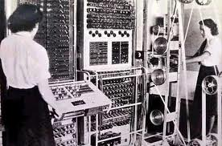
Setting up your clicker
Press “GO”
Then slowly press “0” and then “5” (channel is “05”)
Then slowly press “GO” again
A green light should appear signaling the clicker worked

Slide 20

(3) Process problem documentation
(1): No, process improvements are made when problems occur. | (3): Improvements are made in one week workshops involving all staff, to improve performance in their area of the plant | (5): Exposing problems in a structured way is integral to individuals’ responsibilities and resolution occurs as a part of normal business processes rather than by extraordinary effort/teams

Slide 21
The survey scores to question (3), process problem documentation – all countries, manufacturing
Average 3.13
All countries, manufacturing firms (100 to 5000 employees), 9840 observations

Slide 22
The survey scores to question (3), process problem documentation – US, manufacturing
Average 3.42
US, manufacturing firms (100 to 5000 employees),
1298 observations

Slide 23
The survey scores to question (3), process problem documentation – India, manufacturing
Average 2.64
India, manufacturing firms (100 to 5000 employees),
1137 observations

Slide 24
The survey scores to question (3), process problem documentation – US, Canada and UK, retail
Average 3.07
All countries, retail firms (100 to 5000 employees)
661 observations

Slide 25
The survey scores to question (3), process problem documentation – developed countries, hospitals
Average 3.04
Hospitals, Canada, France, Germany, Italy, Sweden, UK, US, 1183 observations

Slide 26
(4) Performance tracking
Score | (1): Measures tracked do not indicate directly if overall business objectives are being met. Tracking is an ad-hoc process (certain processes aren’t tracked at all) | (3): Most key performance indicators are tracked formally. Tracking is overseen by senior management. | (5): Performance is continuously tracked and communicated, both formally and informally, to all staff using a range of visual management tools.
26
Notes:
26

Slide 27
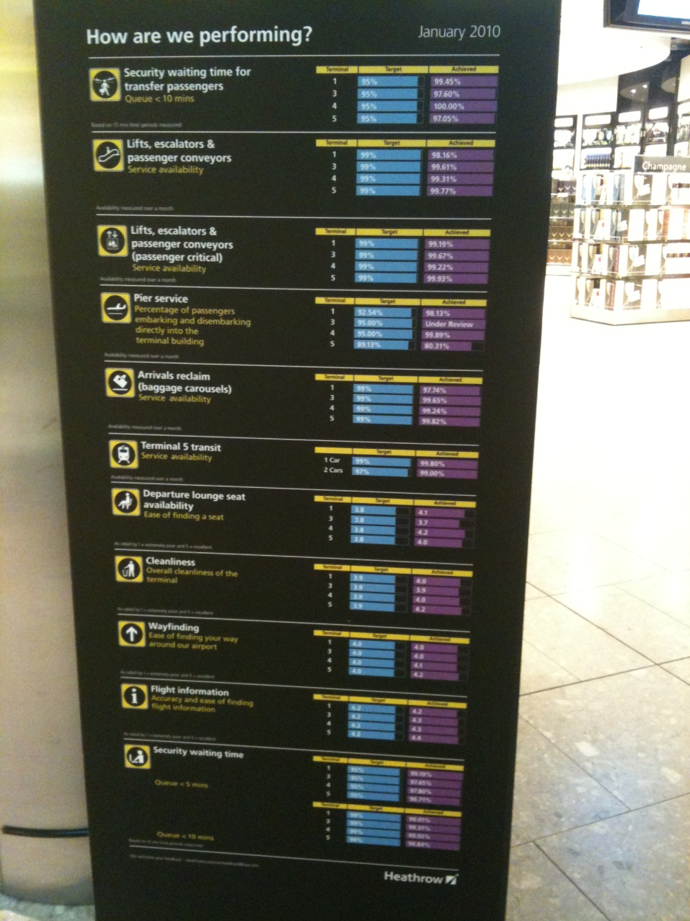
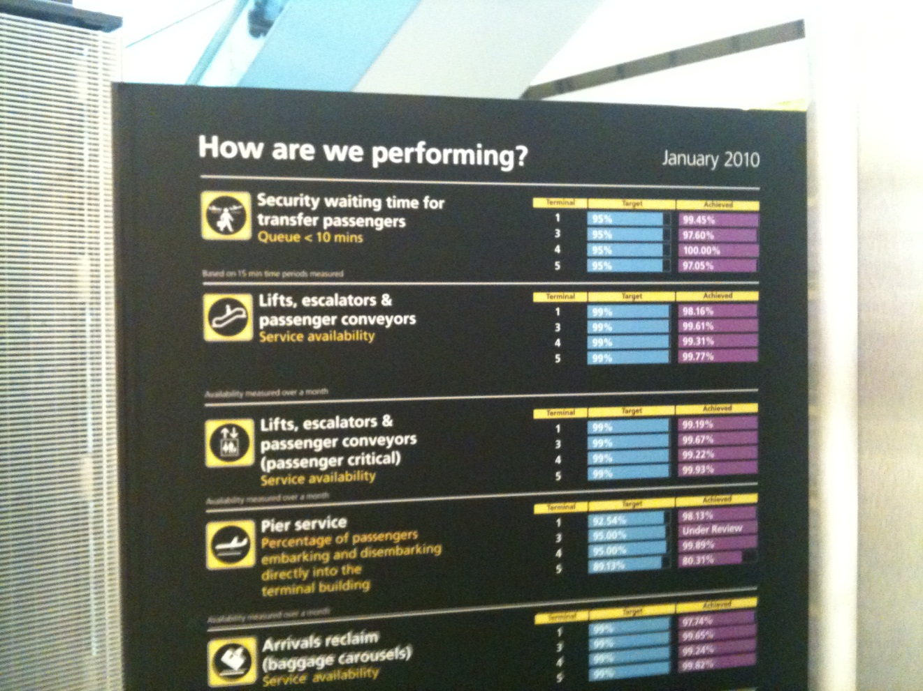
Examples of performance metrics - Heathrow

Slide 28
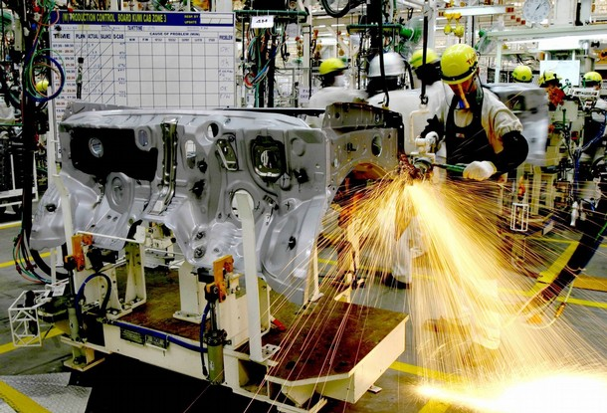
Examples of performance metrics – Toyota

Slide 29
(4) Performance tracking
(1): Measures tracked do not indicate directly if overall business objectives are being met. Tracking is an ad-hoc process (certain processes aren’t tracked at all) | (3): Most key performance indicators are tracked formally. Tracking is overseen by senior management. | (5): Performance is continuously tracked and communicated, both formally and informally, to all staff using a range of visual management tools.

Slide 30
Performance tracking (4): all countries, manufacturing
Average 3.36
All countries, manufacturing firms (100 to 5000 employees), 9838 observations

Slide 31
(5) Performance review
Score | (1): Performance is reviewed infrequently or in an un-meaningful way e.g. only success or failure is noted. | (3): Performance is reviewed periodically with successes and failures identified. Results are communicated to senior management. No clear follow-up plan is adopted. | (5): Performance is continually reviewed, based on indicators tracked. All aspects are followed up ensure continuous improvement. Results are communicated to all staff
31
Notes:
31

Slide 32
(5) Performance review
(1): Performance is reviewed infrequently or in an un-meaningful way e.g. only success or failure is noted. | (3): Performance is reviewed periodically with successes and failures identified. Results are communicated to senior management. No clear follow-up plan is adopted. | (5): Performance is continually reviewed, based on indicators tracked. All aspects are followed up ensure continuous improvement. Results are communicated to all staff

Slide 33
Performance review (5): all countries, manufacturing
Average 3.33
All countries, manufacturing firms (100 to 5000 employees), 9827 observations

Slide 34
(6) Performance dialogue
Score | (1): The right data or information for a constructive discussion is often not present or conversations overly focus on data that is not meaningful. Clear agenda is not known and purpose is not stated explicitly | (3): Review conversations are held with the appropriate data and information present. Objectives of meetings are clear to all participating and a clear agenda is present. Conversations do not, as a matter of course, drive to the root causes of the problems. | (5): Regular review/performance conversations focus on problem solving and addressing root causes. Purpose, agenda and follow-up steps are clear to all. Meetings are an opportunity for constructive feedback and coaching.
34
Notes:
34

Slide 35
(6) Performance dialogue
(1): The right data or information for a constructive discussion is often not present or conversations overly focus on data that is not meaningful. Clear agenda is not known and purpose is not stated explicitly | (3): Review conversations are held with the appropriate data and information present. Objectives of meetings are clear to all participating and a clear agenda is present. Conversations do not, as a matter of course, drive to the root causes of the problems. | (5): Regular review/performance conversations focus on problem solving and addressing root causes. Purpose, agenda and follow-up steps are clear to all. Meetings are an opportunity for constructive feedback and coaching.

Slide 36
Performance dialogue (6): all countries, manufacturing
Average 3.19
All countries, manufacturing firms (100 to 5000 employees), 9794 observations

Slide 37
(1) Modern manufacturing, introduction
Score | (1): Other than JIT delivery from suppliers few modern manufacturing techniques have been introduced, (or have been introduced in an ad-hoc manner) | (3): Some aspects of modern manufacturing techniques have been introduced, through informal/isolated change programs | (5): All major aspects of modern manufacturing have been introduced (Just-in-time, autonomation, flexible manpower, support systems, attitudes and behaviour) in a formal way
37
Notes:
37

Slide 38
Modern manufacturing (1): all countries, manufacturing
Average 2.77
All countries, manufacturing firms (100 to 5000 employees), 9830 observations

Slide 39
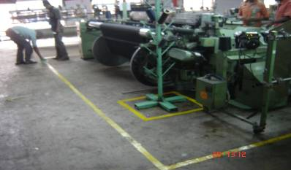
Marking out a factory floor

Slide 40
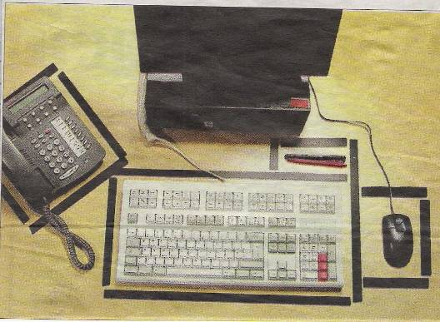
Why Lean is not always good….
The £7 million guide to a tidy desk, London Times, January 5, 2007
Red tape has given way to black marker tape for thousands of bemused civil servants as part of a £7 million paperclip revolution aimed at ensuring that they keep the tools of their trade in the right place. Office workers have been given the tape to mark out where they should put their pens and pencils, their computer keyboards and to indicate where to place their phones.
National Insurance staff have been chosen as guinea-pigs for the latest phase of the “Lean” programme brought in by the logistics consultants Unipart. The programme prohibits workers from keeping personal items on their desks.

Slide 41
Measuring management
Danaher
Monitoring management practices
Drivers of good management

Slide 42
COMPETITION & MODELS OF MANAGEMENT
Various ways that competition may influence management
  Selection – badly run firms morel likely to exit
  Effort – forces badly run firms to try harder to survive
We find competition is strongly linked with better management through a mixture of selection & effort

Slide 43
Competition IMPROVES Management
Manufacturing and Retail (the private sector)
Hospitals and Schools
(the public sector)
3
2.8
2.75
2.95
Management score
2.7
2.9
2.65
2.85
2.6
2.8
2.55
0
1
2 to 4
5+
0
1
2 to 4
5+
Number of Reported Competitors
Sample of 9469 manufacturing and 661 retail firms (private sector panel) and 1183 hospitals and 780 schools (public sector panel). Reported competitors defined from the response to the question “How many competitors does your [organization] face?”

Slide 44
FAMILY FIRMS AND MODELS OF MANAGEMENT PRACTICES
Impact of family firms depends on involvement
  Ownership but not management probably positive
    Concentrated ownership so better monitoring
  Management probably negative
    Smaller pool to select CEO from
    Possible “Carnegie” effect on future CEO’s
    Less career incentive for non-family managers
Notes:
Bandiera et al find that family ownership helps reduce CEO slack (time with outsiders) but NOT when family member IS CEO

Slide 45
Family firms typically have the worst management
Dispersed Shareholders
Private Equity
Family owned, non-family CEO
Managers
Private Individuals
Government
Family owned, family CEO
Founder owned, founder CEO
2.7
2.8
2.9
3
3.1
3.2
Management score (by ownership type)
Management scores after controlling for country, industry and number of employees. Data from 9085 manufacturers and 658 retailers. “Founder owned , founder CEO” firms are those still owned and managed by their founders. “Family firms” are those owned by descendants of the founder “Dispersed shareholder” firms are those with no shareholder with more than 25% of equity, such as widely held public firms.

Slide 46
Education for Non-Managers and Managers Appear Linked to Better Management
Non-managers
Managers
3.3
3.1
3.2
3
3.1
2.9
3
Management score
2.8
2.9
2.7
2.8
2.7
2.6
2.6
2.5
0
1 to 10
11 to 25
26 to 50
50+
0
1 to 10
11 to 25
26 to 50
50+
Percentage of employees with a college degree (%)
Sample of 8,032 manufacturing and 647 retail firms.

Slide 47
SUMMARY OF SOME DETERMINANTS OF MANAGEMENT (& PRODUCTIVITY)
Product market competition
Meritocratic CEO selection
Human Capital
Others
  public sector
  Multinationals
  private equity
  Labor market regulations
Note Danaher selecting industries where there is “low hanging fruit” to improve management

Slide 48
My favourite quotes
The bizarre
Interviewer: “[long silence]……hello, hello….are you still there….hello”
Production Manager: “…….I’m sorry, I just got distracted by a submarine surfacing in front of my window”
The unbelievable
[Male manager speaking to a female interviewer]
Production Manager: “I would like you to call me “Daddy” when we talk”
[End of interview…]

Slide 49
Wrap up
1) Large variation in monitoring practices – best organizations monitor everything and feed into continuous improvement systems
2) Variation common across all industries we have looked at – manufacturing, retail, schools, hospitals, clinics and charities
3) So potential for improvement is extensive, especially in smaller organizations, in less competitive areas in developing countries
Next lecture we will focus on targets – what you do with your monitoring data
49
Notes:
49

Slide 50
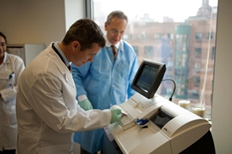
The Problems of Primogeniture…..
HRH the Crown Prince of Denmark Inaugurates Radiometer Equipment at Mount Sinai Hospital

Slide 51
The survey scores to question (3), process problem documentation – developed countries, schools
Average 2.93
Schools, Canada, Germany, Sweden, UK, US
780 observations

Slide 52

Examples of performance metrics – Call Centre

Slide 53
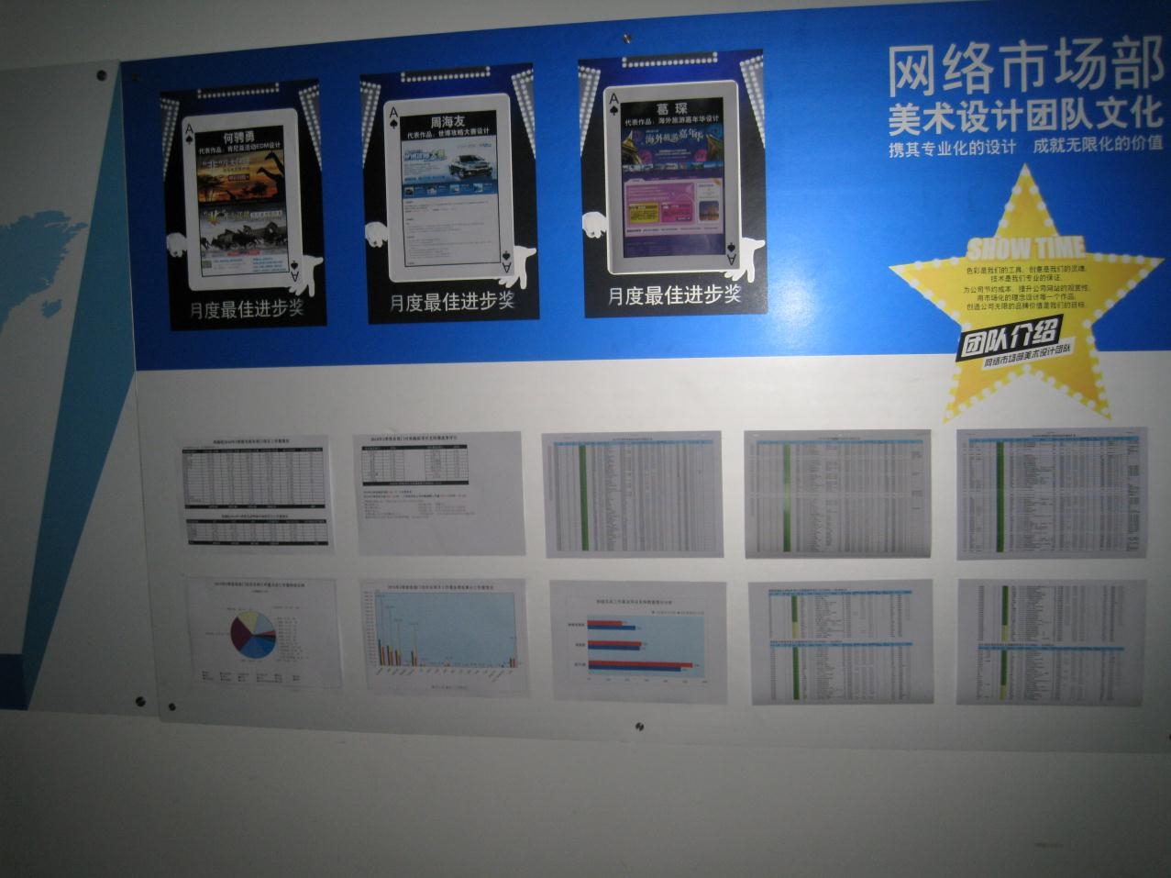
Examples of performance metrics – Call Centre

Slide 54
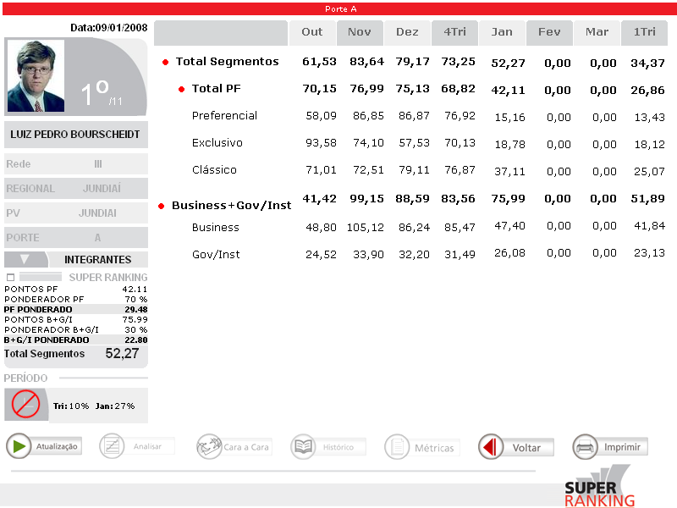
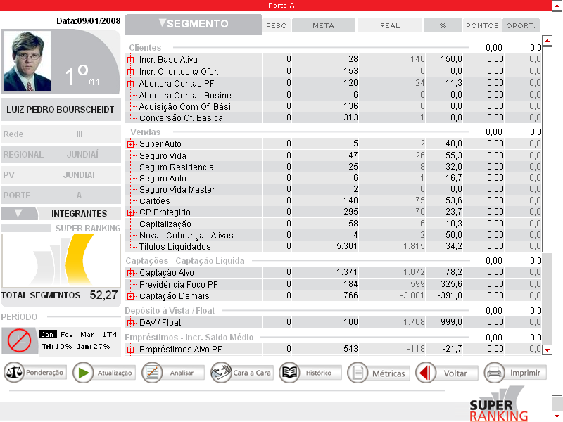
Examples of metrics – Retail Bank (1/2)

Slide 55
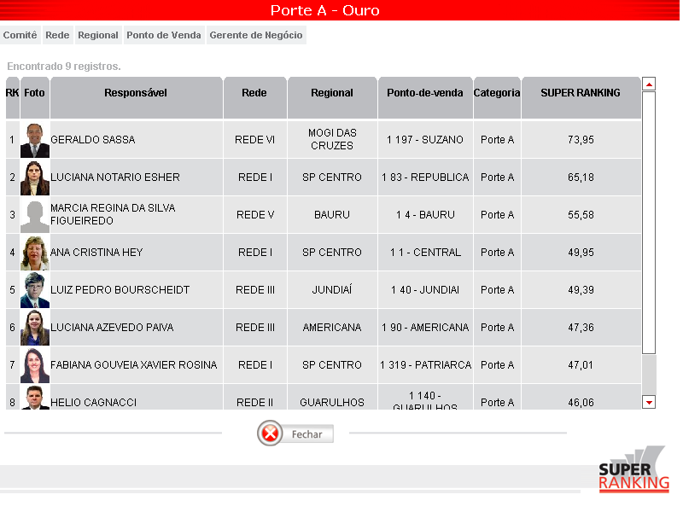
Examples of metrics – Retail Bank (2/2)

Slide 56
We also got managers to self score themselves at the end of the interview
We asked:
“Excluding yourself, how well managed would you say your firm is on a scale of 1 to 10, where 1 is worst practice, 5 is average and 10 is best practice”
We also asked them to give themselves scores on operations and people management separately

Slide 57
Managers generally over-scored their firms
“Worst Practice”
“Average”
“Best Practice”

Slide 58
Self-scores were also not linked to firm performance
Correlation
0.032*
Labor Productivity
Self scored management
* In comparison the management score has a 0.295 correlation with labor productivity

Slide 59
(2) Modern manufacturing, rationale
Score | (1): Modern manufacturing techniques were introduced because others were using them. | (3): Modern manufacturing techniques were introduced to reduce costs | (5): Modern manufacturing techniques were introduced to enable us to meet our business objectives (including costs)
59
Notes:
59

Slide 60
Modern manufacturing, rationale (1): all countries, manufacturing
Average 2.89
All countries, manufacturing firms (100 to 5000 employees), 9595 observations

