Slide 1



Management Practices in Europe, the US and Emerging Markets
Nick Bloom (Stanford Economics and GSB)
John Van Reenen (LSE and Stanford GSB)
Lecture 1: Management and firm Performance

Slide 2
COURSE OUTLINE
Why management can make the world a better place
  Raising productivity & wellbeing
How can we measure management?
  Monitoring/operations
  People/incentives
  Targets
Management experiments
Management in hospitals & schools
Some themes:
  Using data & case studies
  What causes better management?
  What is the causal impact of management?

Slide 3
Class Question
What are the pros and cons of case-studies for management teaching and research?

Slide 4
Why care about management and productivity?
Measuring management

Slide 5
Productivity
Gross Domestic Production (GDP) per capita – basically Income per person – is a key indicator of economic wellbeing
GDP per capita increases by growth of inputs (e.g. more capital or labor) or higher Total Factor Productivity (TFP)
Note: per capita GDP falls if employment rate (employment/population) falls (e.g. Unemployment rises) even if productivity constant
GDP = Inputs + Total Factor Productivity (TFP)
e.g. Labor, capital
Notes:
Problems with GDP – diff capital stocks, inequality, doesnt measure important things like crime, environment, etc.

Slide 6
Productivity “Facts”
Macro: Productivity varies a lot across countries & time
  Robert Solow: TFP growth at least as important as growth of inputs in explaining economic growth
  Cross country GDP/capita differences largely due to TFP differences
  US Productivity slowdown 1973-1995 and broad-based “productivity miracle” post 1995
Micro: Productivity varies hugely across firms

Slide 7

In long-run most countries have enjoyed catch up
Growth with the GDP/head leader (US) but not all
Source: Maddison (2008) Data is smoothed by decade
Notes:
“Rising Sun” Catch up growth by technology transfer – but which technologies? Japanese lean manufacturing

Slide 8
Large Income & TFP Differences between countries
Source: Jones and Romer (2009). US=1
Notes:
This illustrates
TFP important for GDP per capita; ii) Huge differences in GDP per capita and TFP between countries; iii) TFP accounts for about ½ of GDP per capita differences

Slide 9
Why it matters for policy
Increasing TFP means that the economic “pie” is bigger so more room for
  Consumption increases
  Tax cuts
  Increases in public goods (e.g. Environmental quality)
Harder to achieve if productivity stagnant
But what can be done to increase productivity?

Slide 10
Factors increasing productivity
Proximate factors:
  “Hard” technology (e.g. Research & Development)
  Skills (e.g. Expansion of college education)
  Management (a technology & a skill?)
Some deeper factors “driving” the above
  Competition
  Globalization
  Regulations & government policies
  Legal
  Culture

Slide 11
Productivity Differences across firms within countries is huge
US Census data on population of plants
  Plant at 90th percentile has labor productivity 4x plant at the 10th percentile (Syverson, 2004), TFP 2x
Not just mismeasured prices: we see these differences in detailed industries where we measure plant prices (e.g. boxes, bread, block ice, concrete, plywood, etc.)
These firm-level productivity differences could account for large part of cross country differences.....
Notes:
UK 2000 plant at the 90th percentile productivity 5x plant at the 10th percentile (Criscuolo et al, 2006); 1/3 of TFP quintile don’t move in a 5 year period (Bartelsman & Dhrymes)

Slide 12
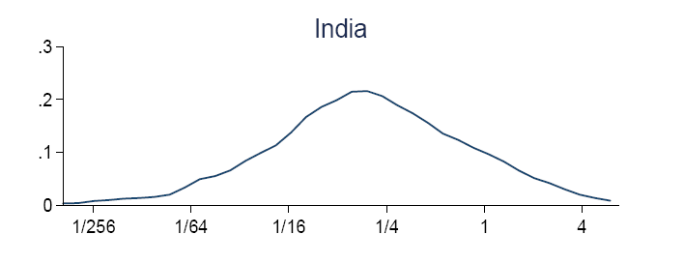
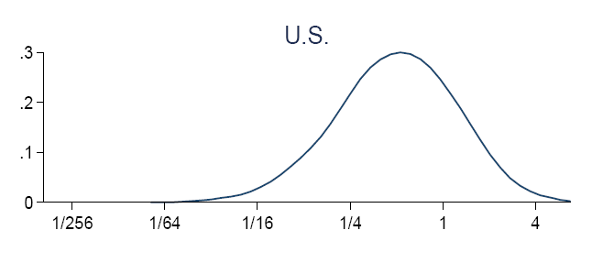
Distribution of plant TFP differences: US-Indian productivity gap related to US having far fewer low productivity plants
Source: Hsieh and Klenow (2008); mean=1

Slide 13
How Aggregate Total Factor Productivity (TFP) increases
Within Firms (Traditional view)
  The same firms become more productive (e.g. new technology spreads quickly to all firms, like Internet)
Between Firms (“Schumpeterian” view)
  Low TFP firms exit and resources are reallocated to high TFP firms
    High TFP firms expand (e.g. more jobs) & low TFP firms contract (e.g. less jobs)
    Exit/entry
Notes:
UK 2000 plant at the 90th percentile productivity 5x plant at the 10th percentile (Criscuolo et al, 2006)

Slide 14



These two effects are well known to cricket fans
(“batting average” effect)
Within batsman (each batsman improves)
Between batsman (more time for your best batsman)
Notes:
UK 2000 plant at the 90th percentile productivity 5x plant at the 10th percentile (Criscuolo et al, 2006)

Slide 15
Some Empirical Evidence on reallocation
Need large-scale database of many firms/plants
Reallocation appears to be an important factor:
  About half of aggregate TFP growth in a 5 year period in a typical industry due to reallocation
  Following trade liberalizations about half of productivity gains due to shrinking/exit of less productive plants (e.g. Pavcnik, 2002)
  For certain sectors like retail trade, almost all of labor productivity growth is due to exit/entry of stores (Foster et al, 2006)
Caveat:
  Reallocation is not immediate (e.g. trade dislocation). So many oppose trade as these are losers as well as winners
Notes:
UK 2000 plant at the 90th percentile productivity 5x plant at the 10th percentile (Criscuolo et al, 2006)

Slide 16

What about management?
Case studies of management:
  Toyota and British Leyland
  Goldman Sachs and Lehman Brothers
Obviously management matters but
  how to generalize?
  how much does it matter?
  what causes the differences?
Notes:
2009 January. Toyota sold 8.97 million vehicles in 2008, beating the 8.35 million sold by the Detroit auto giant and ending GM's 77-year reign at the top. GM introduced M- forms in 1920s to overtake Ford’s U-Form. Toyota Lean Manufacturing/JIT. Not necessarily management quality.

Slide 17
Class Question
Evaluate the strengths and weaknesses of McKinsey’s research approach in the War for Talent
  What is research method?
  Weaknesses & strengths
  How was it put into practice at Enron?
  Cons (and pros?)

Slide 18
Class Question
Evaluate the strengths and weaknesses of McKinsey’s research approach in the War for Talent

Slide 19
Class Question
Do you think there are any general truths on what defines good and bad management, and how would you test these?

Slide 20
Why care about management and productivity?
Measuring management

Slide 21
The Survey Methodology
1) Developing management questions
  Scorecard for 18 monitoring, targets and incentives practices
  ≈45 minute phone interview of manufacturing plant managers
2) Obtaining unbiased comparable responses (“Double-blind”)
  Interviewers do not know the company’s performance
  Managers are not informed (in advance) they are scored
  Run from London, with same training and country rotation
3) Getting firms to participate in the interview
  Introduced as “Lean-manufacturing” interview, no financials
  Official Endorsement: Bundesbank, PBC, CII & RBI, etc.
  Run by 100+ MBAs (credible with business experience)
21
Notes:
21

Slide 22
Example question: “how is performance tracked?”
Score | (1): Measures tracked do not indicate directly if overall business objectives are being met. Certain processes aren’t tracked at all | (3): Most key performance indicators are tracked formally. Tracking is overseen by senior management | (5): Performance is continuously tracked and communicated, both formally and informally, to all staff using a range of visual management tools
22
Notes:
22

Slide 23
Management practices and performance
Productivity log(sales/employee)
Management score

Slide 24
BETTER PERFORMANCE IS CORRELATED WITH BETTER MANAGEMENT
Dependent variable | Product -ivity | Profits (ROCE) | 5yr Sales growth | Exit
Estimation | OLS | OLS | OLS | Probit
Firm sample | All | All | Quoted | All
Management | 23.3*** | 1.952*** | 6.738*** | -26.2**
Firms | 2,927 | 2,927 | 2,927 | 3,161
Notes: OLS Regressions includes controls for country, industry, year, firm-size, firm-age, skills etc.
Is this causal?
Notes:
Relationship is still there in time series, although much smaller (cf Black and Lynch)

Slide 25
Management practices across countries
Distinct groups
Average Country Management Score

Slide 26
Management practices across firms (US and India)
US, manufacturing, mean=3.33 (N=695)
Density
India, manufacturing, mean=2.69 (N=620)
Density
Firm level management score, manufacturing firms 100 to 5000 employees
26

Slide 27
Wrap up and next class
We see massive variation in GDP per capita across countries and performance across firms
Much of these differences appear to be driven by productivity, with management a key factor explaining this
Next week drill into management practices for monitoring using Danaher case
In advance everyone should use the grid to score a firm – any sector and size – they know to prepare for class discussion

Slide 28
Back Up Slides

Slide 29
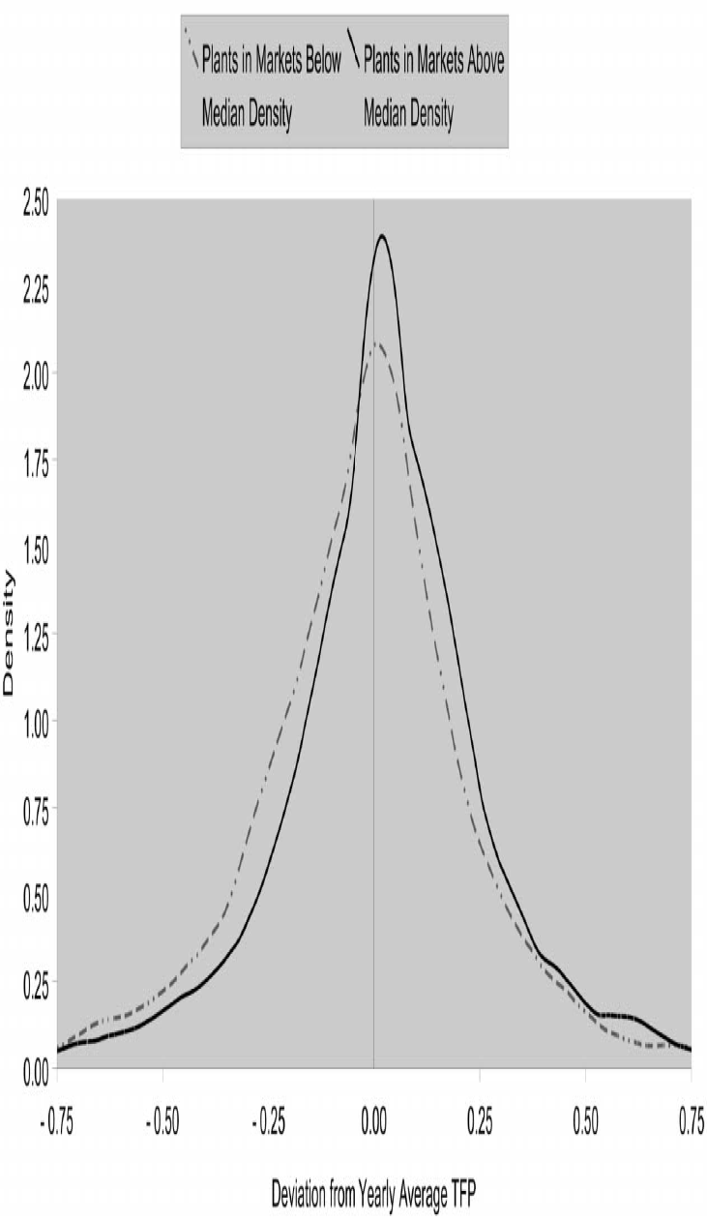
Big TFP dispersion among US ready mix concrete plants: More
Competition means higher productivity (cut off lower tail)
Low competition
High competition
Source: Syverson (2004)
Notes:
Get the exact measures

Slide 30
Variation even greater across firms than across countries
Firm-Level Management Scores

Slide 31
Example of How Total Factor Productivity increases –Firm A twice as productive as firm B
 | Period 1
 | A | B | Total
Productivity -output/jobs | 2 | 1
Jobs | 10 | 10 | 20
Output | 20 | 10 | 30
Aggregate productivity |  |  | 1.5 (=30/20)
Aggregate (weighted) productivity is 1.5
Notes:
UK 2000 plant at the 90th percentile productivity 5x plant at the 10th percentile (Criscuolo et al, 2006)

Slide 32
How Total Factor Productivity increases – both firms increase TFP by 0.5
 | Period 1 |  |  | Period 2
 | A | B | Total | A | B | Total
Productivity | 2 | 1 |  | 2.5 | 1.5
Jobs | 10 | 10 | 20 | 10 | 10 | 20
Output | 20 | 10 | 30 | 25 | 15 | 40
Aggregate productivity |  |  | 1.5 (=30/20) |  |  | 2 (=40/20)
Aggregate productivity increases from 1.5 to 2 (one third)
Notes:
This is the way economists normally think of productivity growth

Slide 33
How Total Factor Productivity increases – both firms increase TFP by 0.5
 | Period 1 |  |  | Period 2
 | A | B | Total | A | B | Total
Productivity | 2 | 1 |  | 2.5 | 1.5
Jobs | 10 | 10 | 20 | 10 | 10 | 20
Output | 20 | 10 | 30 | 25 | 15 | 40
Aggregate productivity |  |  | 1.5 (=30/20) |  |  | 2 (=40/20)
Aggregate productivity increases from 1.5 to 2 (one third)
Notes:
This is the way economists normally think of productivity growth

Slide 34
How Total Factor Productivity increases - reallocate all jobs & output to firm A
 | Period 1 |  |  | Period 2
 | A | B | Total | A | B | Total
Productivity | 2 | 1 |  | 2 | 1
Jobs | 10 | 10 | 20 | 20 | 0 | 20
Output | 20 | 10 | 30 | 40 | 0 | 40
Aggregate productivity |  |  | 1.5 (=30/20) |  |  | 2 (=40/20)
Aggregate productivity increases from 1.5 to 2 (one third)!
Notes:
UK 2000 plant at the 90th percentile productivity 5x plant at the 10th percentile (Criscuolo et al, 2006)

Slide 35
How Total Factor Productivity increases - reallocate all jobs & output to firm A
 | Period 1 |  |  | Period 2
 | A | B | Total | A | B | Total
Productivity | 2 | 1 |  | 2 | 1
Jobs | 10 | 10 | 20 | 20 | 0 | 20
Output | 20 | 10 | 30 | 40 | 0 | 40
Aggregate productivity |  |  | 1.5 (=30/20) |  |  | 2 (=40/20)
Aggregate productivity increases from 1.5 to 2 (one third)!
Notes:
UK 2000 plant at the 90th percentile productivity 5x plant at the 10th percentile (Criscuolo et al, 2006)

