Slide 1




Management Matters in Healthcare
Nick Bloom, August 24th 2011

Slide 2
Big picture question is does management matter in healthcare – can better management save lives?
Literature on management generally poor – case studies
As a result very mixed views:
Some believe management drives everything (believers)
Others believe it doesn’t matter (skeptics)
We wanted to gather large sample international data and test the relevance of management for performance
This slide deck shows some of the first steps

Slide 3
Partners
Academics
Nick Bloom (Stanford)
Christos Genakos (Cambridge)
Rebecca Homkes (LSE)
Renata Lemos (Cambridge)
Raffaella Sadun (Harvard Business School)
Daniela Scur (ICP, Toronto)
John Van Reenen (LSE)
Consultants
Dennis Layton (McKinsey & Co)
Stephen Dorgan (McKinsey & Co)
John Dowdy (McKinsey & Co)

Slide 4
Agenda
1
Measuring management practices in healthcare
2
Describing management across hospitals
3
“Drivers” of management practices
4
Implications for policy makers and others

Slide 5
THE MANAGEMENT SURVEY METHODOLOGY
1) Developing management questions
  18 practice scorecard: “lean” operations, monitoring, targets & incentives
  Interviewed managers & doctors in orthopaedics & cardiology for ~1 hour
2) Getting hospitals to participate in the interview
  Performance indicators from external sources (not interview)
  Endorsement letter from Department of Health
  Run by 4 MBA-types (loud, assertive & experienced)
3) Obtaining unbiased responses (“Double-blind”)
  Interviewers do not know the hospital’s performance
  Interviewees are not informed (in advance) they are scored
Notes:
Interviewees non-UK so not prejudiced one way or another (Greg, Pedro, Kanon, May)

Slide 6
Q1 LEAN OPERATIONS – layout of patient flow
  Can you briefly describe the patient journey for a typical episode?
  How closely located are the wards, theatres and consumables?
  Has the patient flow and the layout of the hospital changed in recent years
Score | (1): Layout of hospital and organisation of workplace is not conducive to patient flow, e.g., ward is on different level from theatre, or consumables are often not available in the right place at the right time | (3): Layout of hospital has been thought through and optimised as far as possible; but workplace organisation is not regularly challenged (and changed) | (5): Hospital layout has been configured to optimize patient flow; workplace organization is challenged regularly and changed when needed
Notes:
5
Examples: “Lean” introduction in Virginia Mason Hospital (VMPS https://www.virginiamason.org/body.cfm?id=5154) explicitly based on Toyota principles. (i) In Oncology ward found that patients moved around different wards unnecessarily. Floyd & Delores Jones Cancer Institute at Virginia Mason redesigned with a laboratory and pharmacy inside, eliminating the need for patients to travel throughout the hospital for chemotherapy. For one patient, this reduced the length of a chemotherapy visit from 10 hours to two and saved about 500 feet of walking at each visit. (ii) Making sure supplies of nursing equipment all in place. Example in NHS hospitals of only one night nurse. Needed to change patient sheets and all sheets where located 2 floors away. When nurse was away, another patient had an attack and died. Problem logged but not dealt with

Slide 7
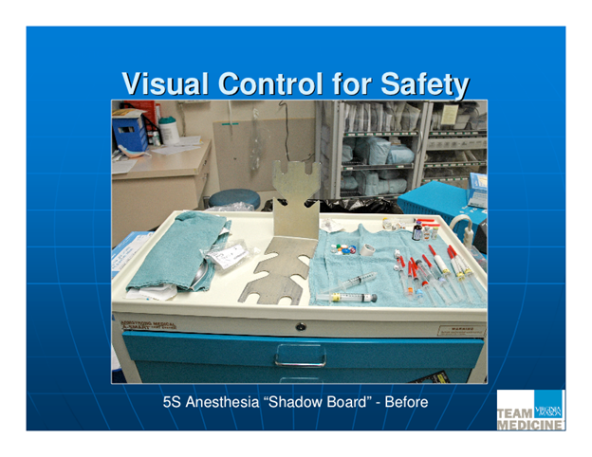
TYPICAL PROCESS IMPROVEMENT(BEFORE)

Slide 8
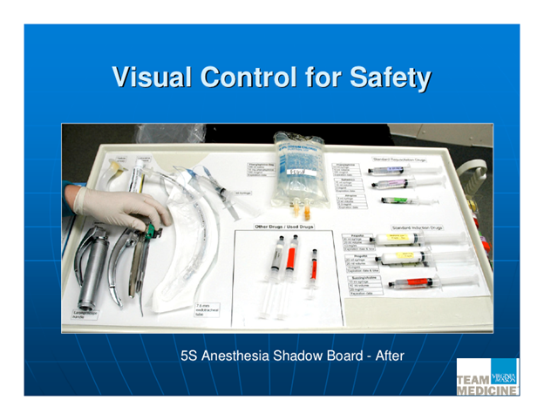
TYPICAL PROCESS IMPROVEMENT (AFTER)
Notes:
standardization & cleaning of anesthesiologist’s instrument tray in time – if not done means delays to starts of operations. Standardization also means greater safety: anesthesiologists like to use different equipment so when there is a last minute change to a different theatre this can confuse them and compromise safety.

Slide 9
Q5 MONITORING – Performance review
How do you review your department’s performance? Tell me about a recent meeting. Who is involved in these meetings? Who gets to see the results. What is the follow-up plan? Can you tell me about the recent follow-up plan?
Score | (1): Performance is reviewed infrequently or in an un-meaningful way e.g. only success or failure is noted | (3): Performance is reviewed periodically with both successes and failures identified. Results are communicated to senior staff. No clear follow up plan is adopted. | (5): Performance is continually reviewed, based on the indicators tracked. All aspects are followed up to ensure continuous improvement. Results are communicated to all staff.

Slide 10
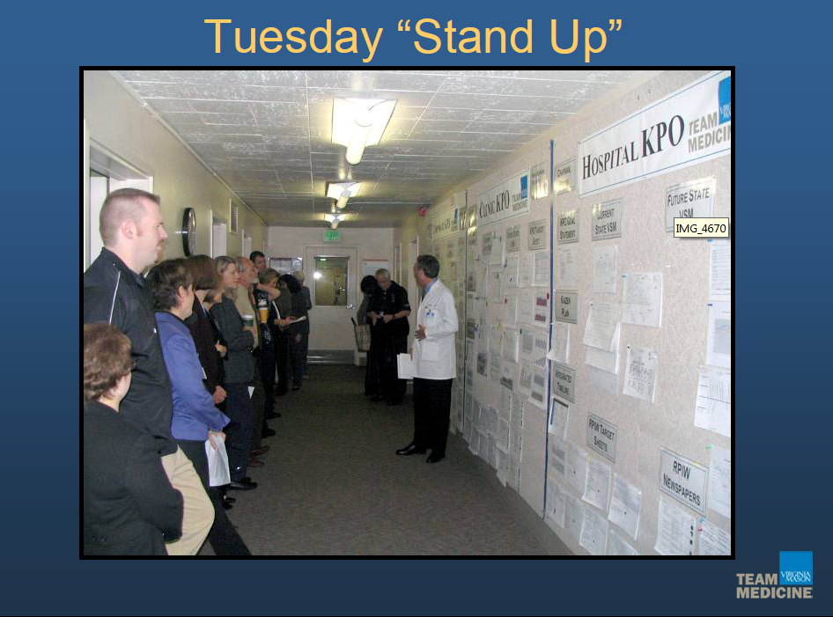
REGULAR PERFORMANCE MONITORING

Slide 11

PERFORMANCE MONITORING MANUFACTURING

Slide 12
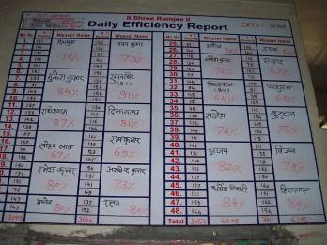
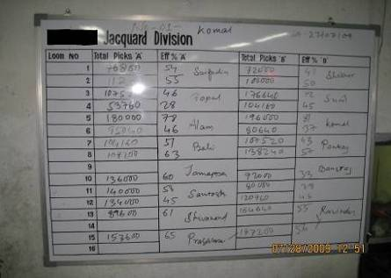
PERFORMANCE MONITORING MANUFACTURING

Slide 13
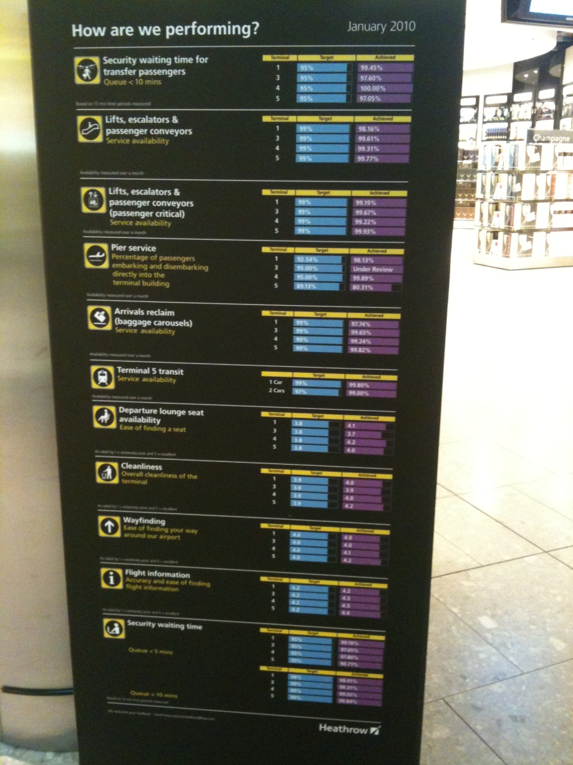
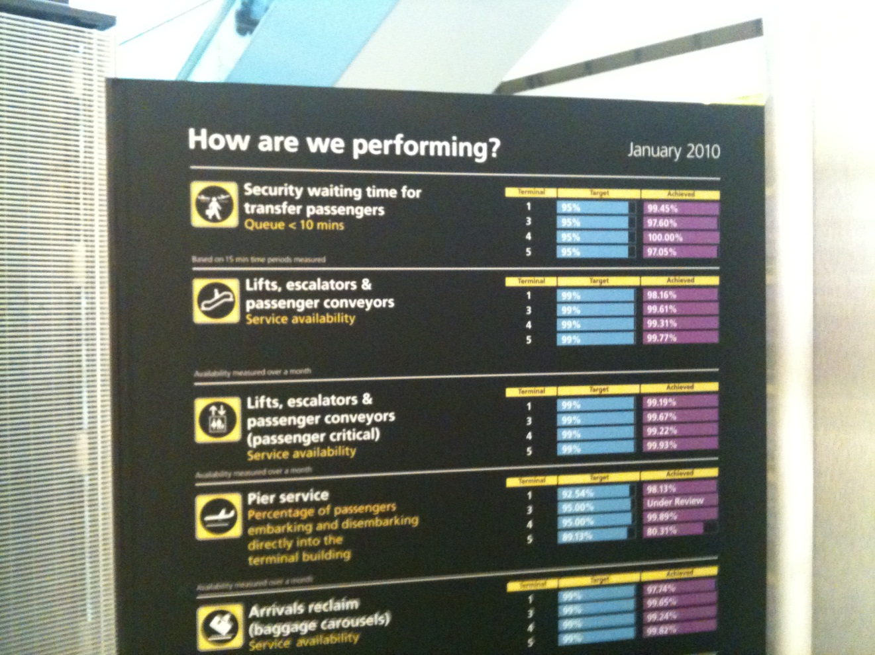
PERFORMANCE MONITORING AIRPORTS

Slide 14
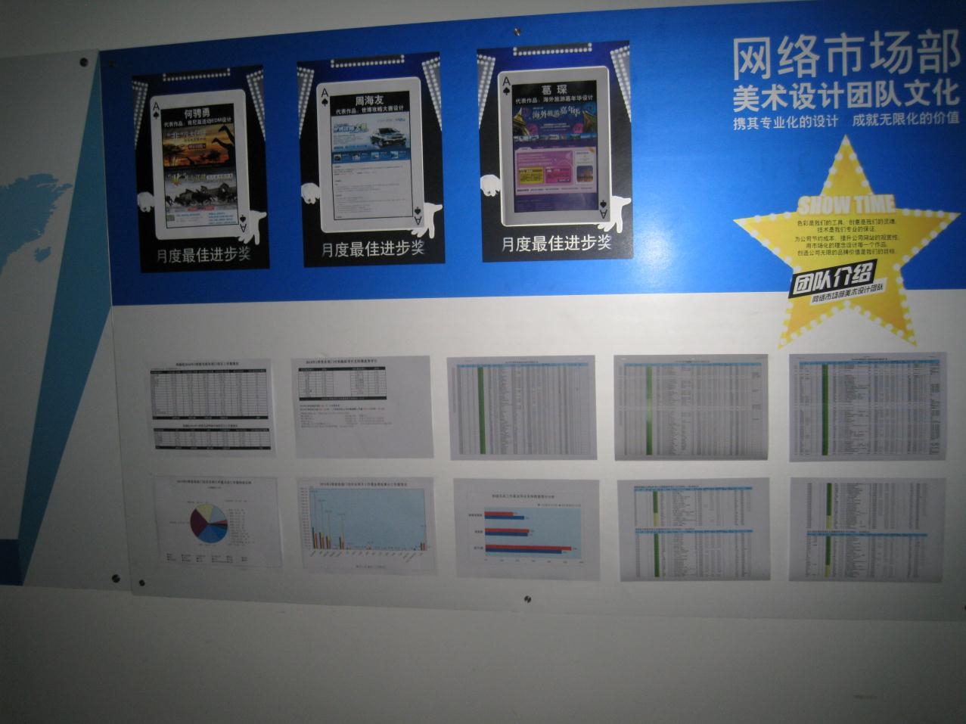
PERFORMANCE MONITORING CALL CENTRE

Slide 15
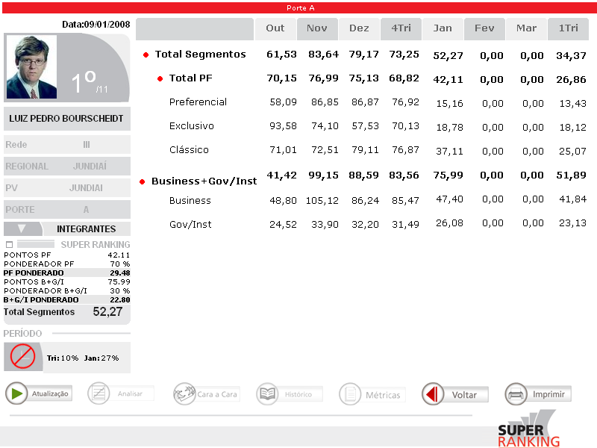
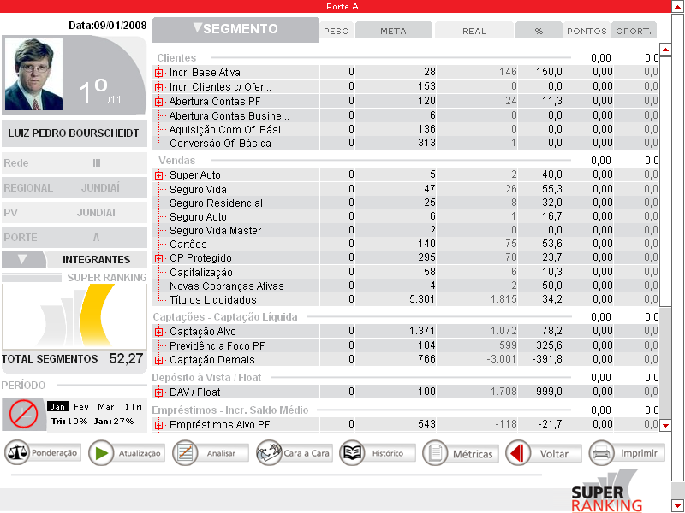
PERFORMANCE MONITORING RETAIL BANKING

Slide 16
Q15 INCENTIVES - Removing poor performers
  If you had a nurse who could not do her job adequately, what would you do? Could you give me a recent example?
  How long would underperformance be tolerated?
  Do some individuals always just manage to avoid being re-trained/fired?
Score | (1): Poor performers are rarely removed from their positions | (3) Suspected poor performers stay in a position for a few years before action is taken | (5): We move poor performers out of the hospital/department or to less critical roles as soon as a weakness is identified
Notes:
15
How do the different staff groups get involved in this process? Can you give examples?

Slide 17
Agenda
1
An overview
2
Measuring management practices in healthcare
3
Describing management across hospitals
4
“Drivers” of management practices
5
Implications for policy makers and others

Slide 18

We interviewed almost 1,200 hospitals across 7 countries
^{l}
Number of interviews
U.S.
U.K.
Canada
Italy
France
Germany
Sweden
Notes:
17
1194 hospitals in public and private sector (184 in UK )
– Response rates uncorrelated with performance
Collect data on many “noise” controls:
– Interviewer fixed effects
– Interview characteristics (e.g. duration, day, time)
– Interviewee characteristics (e.g. tenure, job)
Match to performance and detailed demographics data

Slide 19
We found good management is strongly correlated with better clinical and financial performance
A one point increase in management practice is associated with:
UK Hospitals
  6.5% reduction in risk adjusted 30 days AMI mortality rates
  33% increase in income per bed
  20% increase in the probability that the hospital is above average in terms of patients satisfaction
US Hospitals
  7% reduction in risk adjusted 30 days AMI mortality rates¹
  14% increase in EBITDA per bed
  0.8 increase in the percentage of people that would recommend the hospital
18
Notes:
18
LON-AAA123-20101025-
18

Slide 20
There is a strong relationship between management practice and health outcomes
0
UK heart attack mortality rates
105
95
95
90
Bottom quartile
3rd quartile
2nd quartile
Top quartile
Management practice score
Notes:
Mortality rates as measured by 30 Days risk adjusted AMI Mortality rate (indexed to national average)
SOURCE: Management data from 82 interviews. Dr Fosters quality accounts

Slide 21
Hospital Management Practices Vary Across Countries
Hospitals
Schools
US
UK
Sweden
UK
Canada
Germany
US
Germany
Sweden
2.2
2.4
2.6
2.8
3.0
3.2
Canada
Retail
US
Italy
Canada
France
UK
2.2
2.4
2.6
2.8
3.0
3.2
2.6
2.8
3
3.2
Note: Averages taken across all organizations within each country. 1,183 hospitals, 780 schools and 661 retail sites

Slide 22
Manufacturing: Management Practices Across Countries
US
Japan
Germany
Sweden
Canada
Australia
UK
Italy
France
New Zealand
Mexico
Poland
Republic of Ireland
Portugal
Chile
Argentina
Greece
Brazil
China
India
2.6
2.8
3
3.2
3.4
management
Note: Averages taken across all firms within each country. 9079 observations in total. Firms per country in the right column

Slide 23
Hospitals Management Practices Show A Large Spread
Hospitals
Schools
Retail
US
US
US
1
1.5
1
.5
1
.5
.5
0
0
0
Fraction of Firms
Canada
Canada
Canada
1
1.5
1
.5
1
.5
.5
0
0
0
Europe
Europe
UK
1
1.5
1
.5
1
.5
.5
0
0
0
1
2
3
4
5
1
2
3
4
1
2
3
4
5
Firm management scores, from 1 (worst practice) to 5 (best practice)
Note: Bars are the histogram of the actual density. The line is the smoothed (kernel) of the US density for comparison.

Slide 24
Agenda
1
An overview
2
Measuring management practices in healthcare
3
Describing management across hospitals
4
“Drivers” of management practices
5
Implications for policy makers and others

Slide 25
Ownership: Government Ownership is Associated with Worse Management Across Every Industry We Studied
Manufacturing
Hospitals
Schools
Private
Public
2.8
2.9
3
2.6
2.7
2.8
2.9
2.6
2.7
2.8
2.9
Management score
Management scores after controlling for size (number of employees, beds or students) and country. Data from 9079 manufacturing firms, 1,183 hospital and 779 schools. There were no publicly owned retail firms so the comparison is not possible within retail.

Slide 26
Government ownership is associated with particularly poor incentives management (hiring, firing, pay and promotions)
Gap between public and private ownership by sub-components of management
Manufacturing
Hospitals
Schools
Monitoring management
Targets
management
Incentives
management
-0.2
-0.1
0
-0.3
-0.2
-0.1
0
-0.3
-0.2
-0.1
0
Management score gap between public and privately ownership
Management scores after controlling for size (number of employees, beds or students) and country. Monitoring is collecting and using data, targets are the setting and effectiveness of targets, and incentives is performance related hiring, promotions, bonus and exit. Data from 9079 manufacturers, 1,183 hospital and 779 schools.

Slide 27
Competition: this appears to be good for management
0
Management practice score
2.90
2.82
2.69
2.59
None
1 to 5
5 to 10
More than 10
Number of competitors¹
1 As perceived by the manager.
26
Notes:
26
LON-AAA123-20101025-
None (N=244);
1 to 5 (N=701);
5 to 10 (N=183);
More than 10 (N=63)

Slide 28
Competition appears to matter in every industry we studied
Manufacturing and Retail (the private sector)
Hospitals and Schools
(the public sector)
3
2.8
2.75
2.95
Management score
2.7
2.9
2.65
2.85
2.6
2.8
2.55
0
1
2 to 4
5+
0
1
2 to 4
5+
Number of Reported Competitors
Sample of 9469 manufacturing and 661 retail firms (private sector panel) and 1183 hospitals and 780 schools (public sector panel). Reported competitors defined from the response to the question “How many competitors does your [organization] face?”

Slide 29
Training and Education: appears linked to better Management (at least in manufacturing and retail)
Non-managers
Managers
3.3
3.1
3.2
3
3.1
2.9
3
Management score
2.8
2.9
2.7
2.8
2.7
2.6
2.6
2.5
0
1 to 10
11 to 25
26 to 50
50+
0
1 to 10
11 to 25
26 to 50
50+
Percentage of employees with a college degree (%)
Sample of 8,032 manufacturing and 647 retail firms. We did not collect comparable education data in hospitals and schools.

Slide 30
Hospitals with more clinicians as managers (a more hospital relevant skills measure) have better management
2
Management score relative to national mean
1.02
Bottom quartile
2nd quartile
3rd quartile
Top quartile
Proportion of managers with a clinical degree
Notes:
29
LON-AAA123-20101025-
The average management score in deviation from country means.
Italy is excluded as it is a legal requirement that all general managers have clinical degrees

Slide 31
Changes in clinically trained managers are also correlated with improved management practices
Change in management practice score 2006 to 2009 ¹
Bottom quartile
2nd quartile
3rd quartile
Top quartile
Change in the proportion of managers
with a clinical degree¹
1 Percent
30
Notes:
30
LON-AAA123-20101025-
Data:
Refers to UK only, between 2006 and 2009.
Collected during 68 interviews in 2006 and 53 interviews in 2009, 41 Hospitals

Slide 32
There is wide variation in the prevalence of clinically trained managers by country
Percentage of managers with a clinical degree¹
Sweden
US
Canada
Germany
France
UK
1 Italy excluded as it is a legal requirement that all general managers have clinical degrees
31
Notes:
31
LON-AAA123-20101025-

Slide 33
Size: There is a strong relationship between hospital size and management practice
0
Management practice score
2.80
2.71
2.65
2.44
<100
100-499
500-1,499
>1,499
Number of employees¹
1 Directly employed by the hospital
32
32
Notes:
32
LON-AAA123-20101025-

Slide 34
Agenda
1
An overview
2
Measuring management practices in healthcare
3
Describing management across hospitals
4
“Drivers” of management practices
5
Implications for policy makers and others

Slide 35
These findings pose some questions for policy makers and managers (noting we can not be sure of causality)
  Can greater private ownership help to improve management?
  Can greater competition be fostered without losing scale economies?
  Can the trend to more clinically qualified managers be accelerated?
34
Notes:
34
LON-AAA123-20101025-
^{LOX-AAA123-20050610-}
³⁴

Slide 36
MY FAVOURITE QUOTES:
Don’t get sick in Britain
Interviewer : “Do staff sometimes end up doing the wrong sort of work for their skills?
NHS Manager: “You mean like doctors doing nurses jobs, and nurses doing porter jobs? Yeah, all the time. Last week, we had to get the healthier patients to push around the beds for the sicker patients”

Slide 37
MY FAVOURITE QUOTES:
The traditional British Chat-Up
[Male manager speaking to an Australian female interviewer]
Production Manager: “Your accent is really cute and I love the way you talk. Do you fancy meeting up near the factory?”
Interviewer “Sorry, but I’m washing my hair every night for the next month….”

Slide 38
MY FAVOURITE QUOTES:
The difficulties of defining ownership in Europe
Production Manager: “We’re owned by the Mafia”
Interviewer: “I think that’s the “Other” category……..although I guess I could put you down as an “Italian multinational” ?”
Americans on geography
Interviewer: “How many production sites do you have abroad?
Manager in Indiana, US: “Well…we have one in Texas…”

Slide 39
MY FAVOURITE QUOTES:
The bizarre
Interviewer: “[long silence]……hello, hello….are you still there….hello”
Production Manager: “…….I’m sorry, I just got distracted by a submarine surfacing in front of my window”
The unbelievable
[Male manager speaking to a female interviewer]
Production Manager: “I would like you to call me “Daddy” when we talk”
[End of interview…]

Slide 40
Management Matters in Healthcare

Slide 41
Figure 10: Labor Market Regulation Seems to Inhibit Good Management Practices, Particularly Incentives Management
3.2
US
3
Germany
Incentives Management (management sample)
Canada
UK
Japan
2.8
Great Britain
Poland
Sweden
Republic of Ireland
Australia
Italy
Mexico
France
Chile
China
2.6
New Zealand
India
Portugal
Greece
Argentina
Brazil
0
10
20
30
40
50
60
World Bank Rigidity of employment index (0-100)
Note: Averaged across all manufacturing firms within each country (9079 observations). We did not include other sectors as we do not have the same international coverage. Incentives management defined as management practices around hiring, firing, pay and promotions. The index is from the Doing Business database http://www.doingbusiness.org/ExploreTopics/EmployingWorkers/

Slide 42
Autonomy: Managerial Autonomy is correlated with management practice
0.29
Managerial Autonomy
Bottom quartile
2nd quartile
3rd quartile
Top quartile
Management practice score
41
Notes:
41
LON-AAA123-20101025-
Autonomy Measured as the z-scored average of 4 questions:
Autonomy to hire a full time permanent nurse;
Autonomy to add more beds to the specialty;
Largest capital expenditures with out prior authorization from the CEO;
Autonomy to set own budget and make strategic investments

