Slide 1
Does management matter: evidence from India
Nick Bloom (Stanford)
Benn Eifert (Berkeley)
Aprajit Mahajan (Stanford)
David McKenzie (World Bank)
John Roberts (Stanford)
July 22nd 2010

Slide 2
Management appears better in rich countries
Average country management score, manufacturing firms 100 to 5000 employees
(monitoring, targets and incentives management scored on a 1 to 5 scale, see Bloom and Van Reenen (2007, QJE) and Bloom, Sadun and Van Reenen (2010, JEP))
2

Slide 3
With a huge spread within almost all countries
US, manufacturing, mean=3.33 (N=695)
Density
India, manufacturing, mean=2.69 (N=620)
Density
Firm level management score, manufacturing firms 100 to 5000 employees
3

Slide 4
But do we care - does management matter?
Long debate between business practitioners versus economists
Evidence to date primarily case-studies and surveys
So in India we ran a management field experiment

Slide 5
We investigate these questions in large Indian firms
Took large firms (≈ 300 employees) outside Mumbai making cotton fabric. Randomized treatment plants get heavy management consulting, controls plants get very light consulting.
Collect weekly data on all plants from 2008 to 2010
1) Profits and productivity up by about 20%
2) Decentralization of power within firms
3) Increased computerization

Slide 6
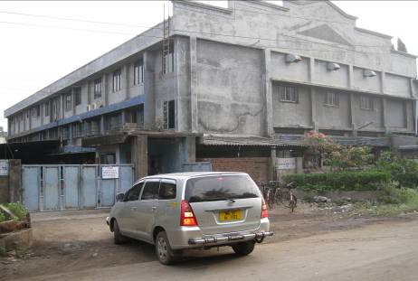
Exhibit 1: Plants are large compounds, often containing several buildings.

Slide 7
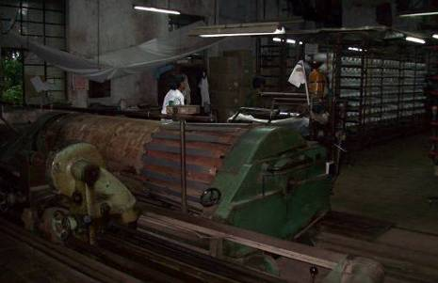
Exhibit 2a: Plants operate continuously making cotton fabric from yarn
Fabric warping

Slide 8
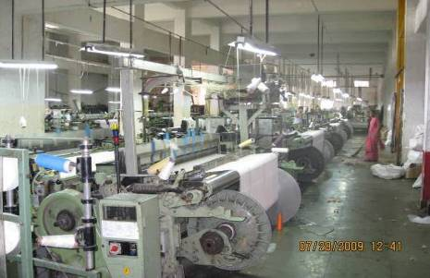
Exhibit 2b: Plants operate continuously making cotton fabric from yarn
Fabric weaving

Slide 9
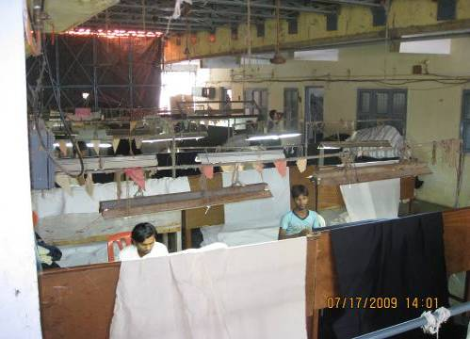
Exhibit 2c: Plants operate continuously making cotton fabric from yarn
Quality checking

Slide 10
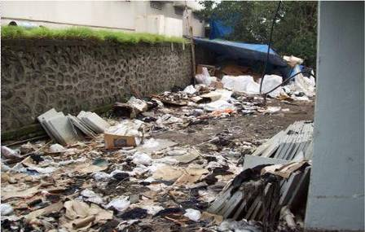
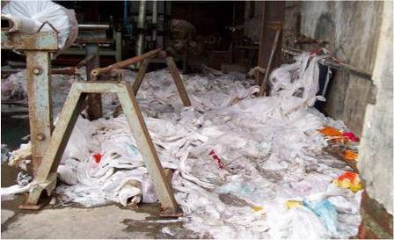
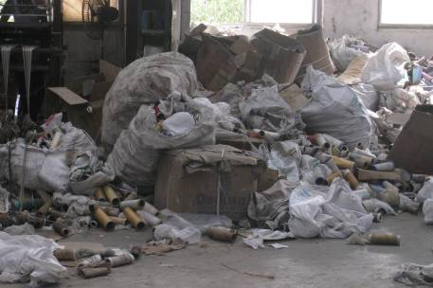
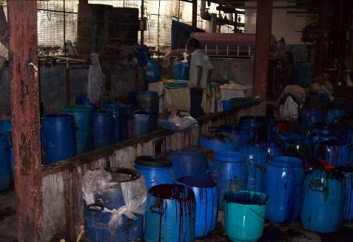
Exhibit 3: Many parts of these Indian plants were dirty and unsafe
Garbage outside the plant
Garbage inside a plant
Flammable garbage in a plant
Chemicals without any covering

Slide 11
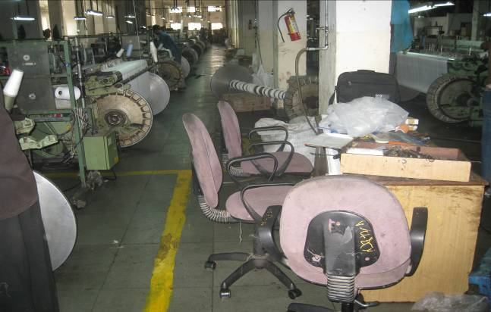
Exhibit 4: The plant floors were often disorganized and aisles blocked

Slide 12
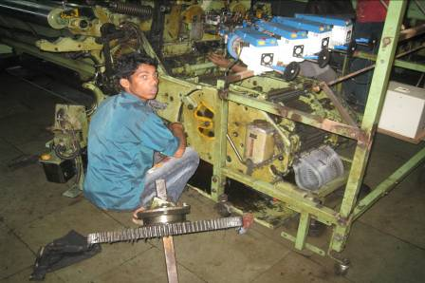
Exhibit 5: There was almost no routine maintenance – instead machines were only repaired when they broke down

Slide 13
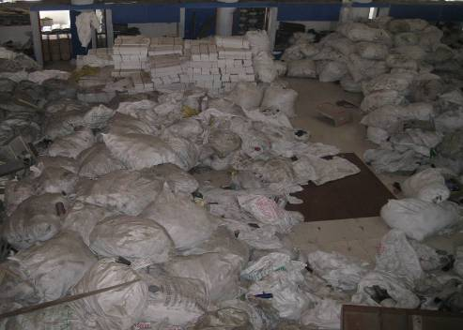
Exhibit 6a: Inventory was not well controlled – firms had months of excess yarn, typically stored in an ad hoc way all over the factory

Slide 14
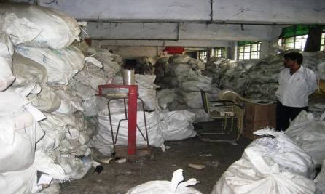
Exhibit 6b: Inventory was not well controlled – firms had months of excess yarn, typically stored in an ad hoc way all over the factory

Slide 15
Management practices before and after treatment
Performance of the plants before and after treatment
Why were these practices not introduced before?
Decentralization and IT
15

Slide 16
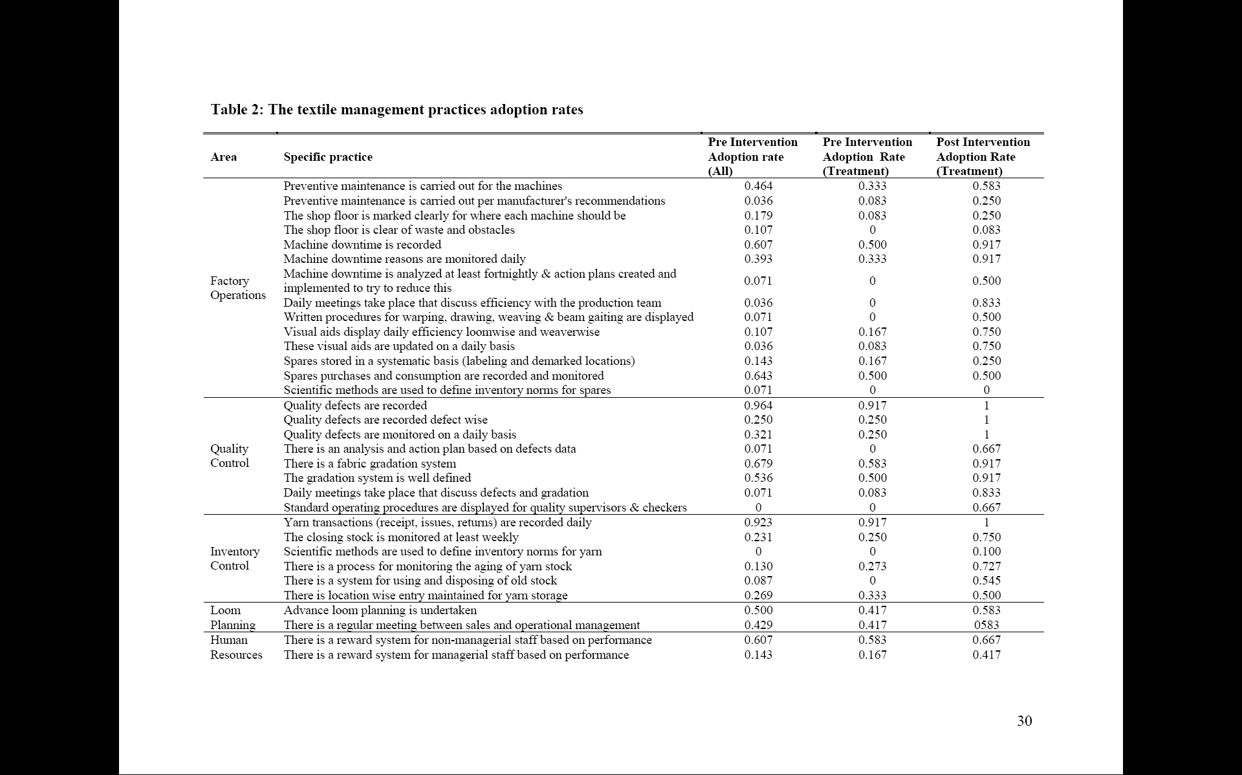
Intervention aimed to improve 38 core textile management practices in 6 areas

Slide 17
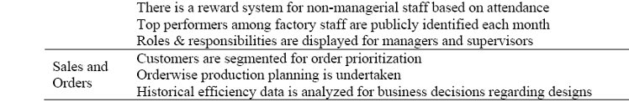
Intervention aimed to improve 38 core textile management practices in 6 areas

Slide 18
Adoption of these 38 management practices did rise, and particularly in the treatment plants
Treatment plants (on-site)
Control plants (on-site)
Share of key textile management practices adopted
Excluded plants
(not treatment or control)

Slide 19
Management practices before and after treatment
Performance of the plants before and after treatment
Quality
Inventory
Output
Why were these practices not introduced before?
Decentralization and IT

Slide 20
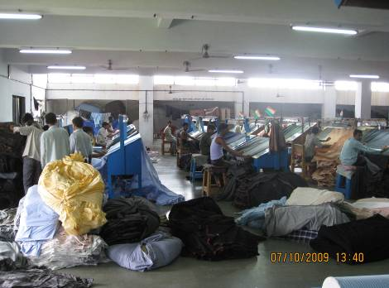
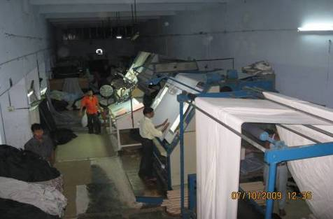
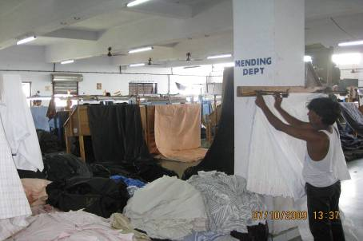
Poor quality meant 19% of manpower went on repairs
Large room full of repair workers (the day shift)
Workers spread cloth over lighted plates to spot defects
Defects are repaired by hand or cut out from cloth
Defects lead to about 5% of cloth being scrapped
Notes:
Above-left and right: mending department, Riviera Fashions. Below-left: mending department, Mahajan silk mills.
20

Slide 21
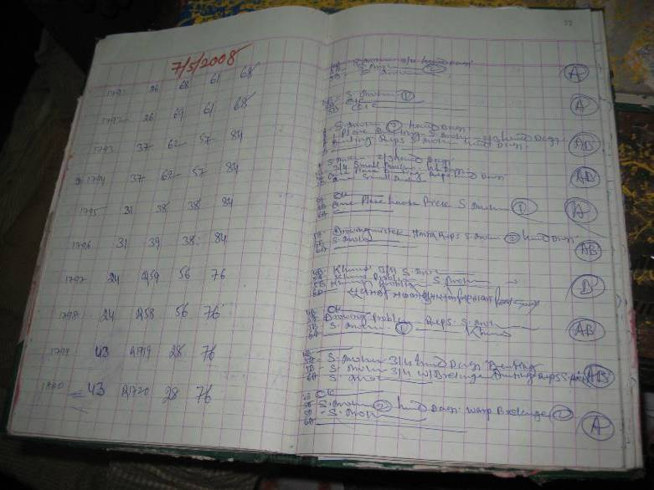
Previously mending was recorded only to cross-check against customers’ claims for rebates
Defects log with defects not recorded in an standardized format. These defects were recorded solely as a record in case of customer complaints. The data was not aggregated or analyzed
Notes:
21

Slide 22
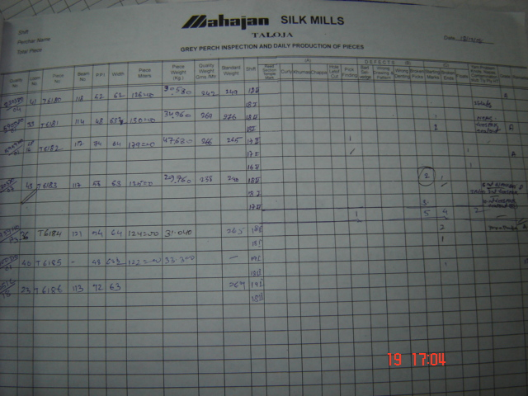
Now mending is recorded daily in a standard format, so it can analyzed by loom, shift, design & weaver
22
Notes:
22

Slide 23
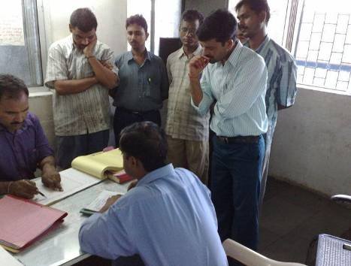
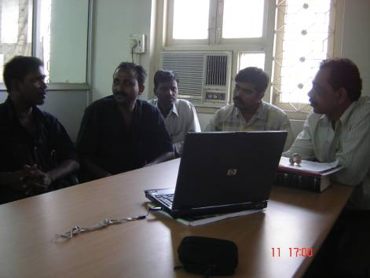
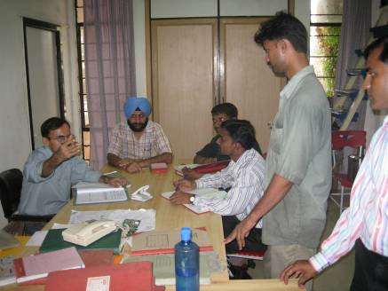
The quality data is now collated and analyzed as part of the new daily production meetings
Plant managers now meet regularly with heads of quality, inventory, weaving, maintenance, warping etc. to analyze data

Slide 24
Figure 3: Quality defects index for the treatment and control plants
Start of Diagnostic
Start of Implementation
End of Implementation
97.5th percentile
Control plants
Average (♦ symbol)
Quality defects index (higher score=lower quality)
2.5th percentile
97.5th percentile
Treatment plants
Average (+ symbol)
2.5th percentile
Weeks after the start of the diagnostic

Slide 25
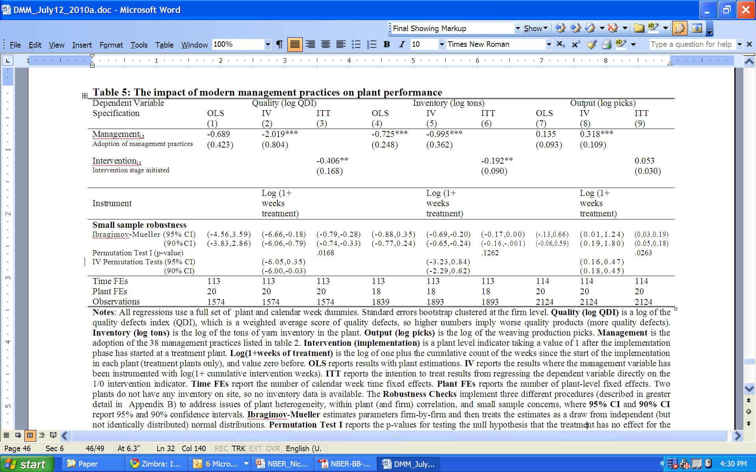
Quality results in regression format
Note: standard errors boostrap clustered by firm

Slide 26
Management practices before and after treatment
Performance of the plants before and after treatment
Quality
Inventory
Output
Why were these practices not introduced before?
Decentralization and IT
26

Slide 27
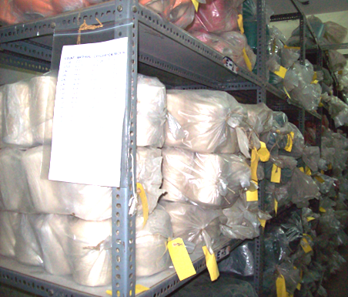
Organizing and racking inventory enables firms to slowly reduce their capital stock

Slide 28
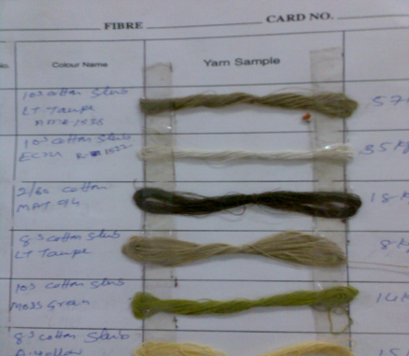
Sales are also informed about excess yarn stock so they can incorporate this in new designs.
Shade cards now produced for all surplus yarn. These are sent to the design team in Mumbai to use in future products

Slide 29
Inventory results in regression format
Note: standard errors boostrap clustered by firm

Slide 30
Management practices before and after treatment
Performance of the plants before and after treatment
Quality
Inventory
Output
Why were these practices not introduced before?
Decentralization and IT
30

Slide 31
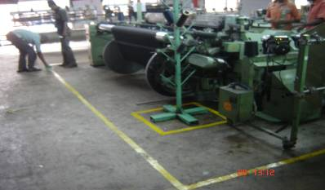
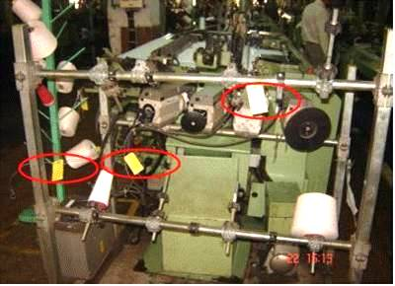
Many treated firms have also introduced basic initiatives (called “5S”) to organize the plant floor
Worker involved in 5S initiative on the shop floor, marking out the area around the model machine
Snag tagging to identify the abnormalities on & around the machines, such as redundant materials, broken equipment, or accident areas. The operator and the maintenance team is responsible for removing these abnormalities.

Slide 32
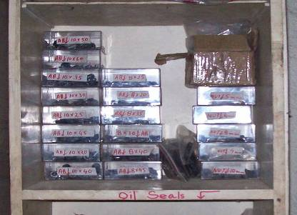
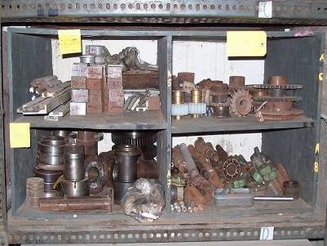
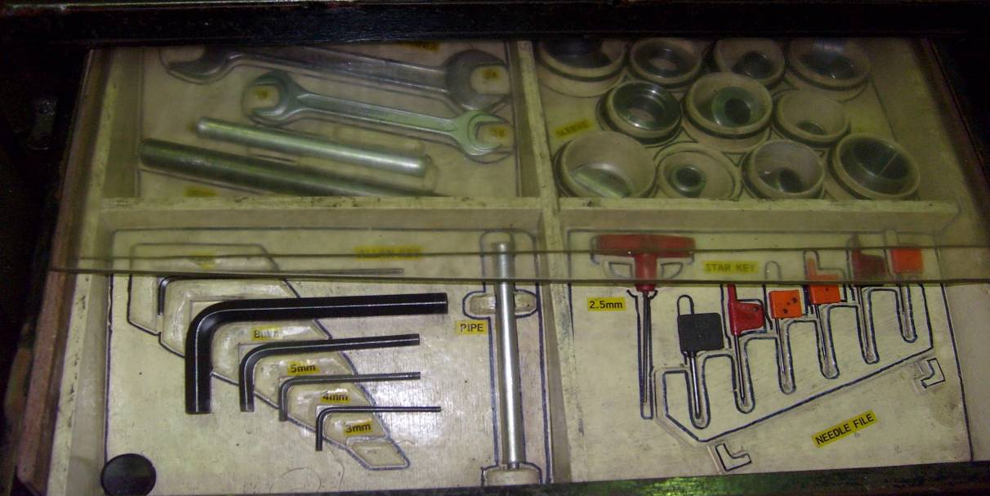
Spare parts were also organized, reducing downtime (parts can be found quickly) and waste
Nuts & bolts sorted as per specifications
Parts like gears, bushes, sorted as per specifications
Tool
storage organized

Slide 33
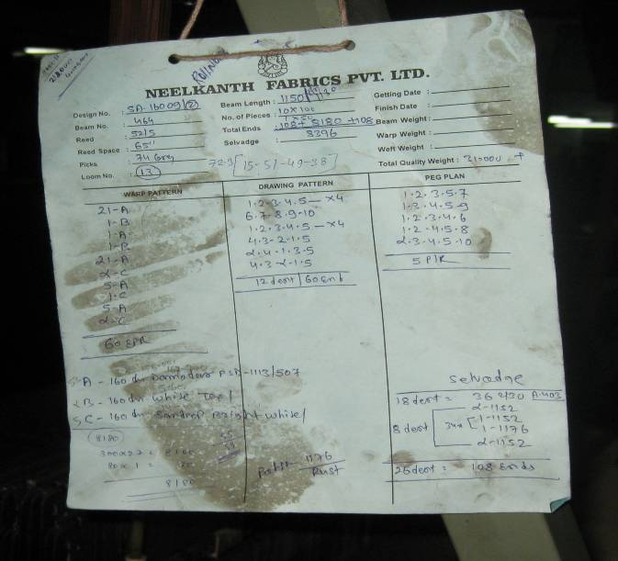
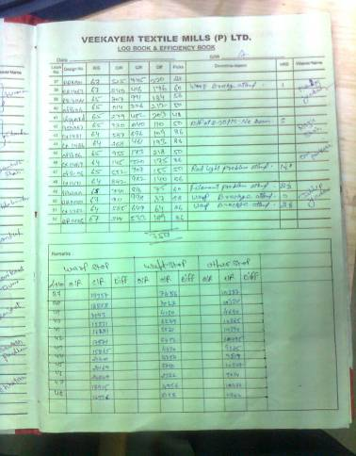
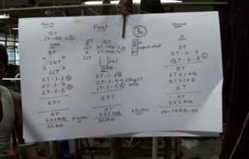
Production data is now collected in a standardized format, for discussion in the daily meetings
After
(standardized, so easy to enter daily into a computer)
Before
(not standardized, on loose pieces of paper)

Slide 34
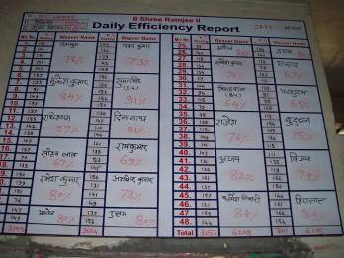
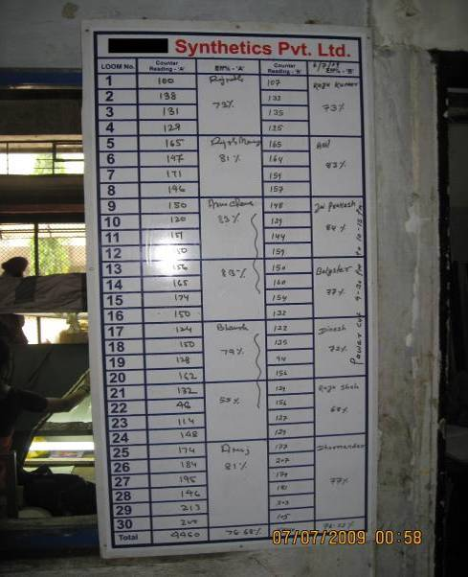
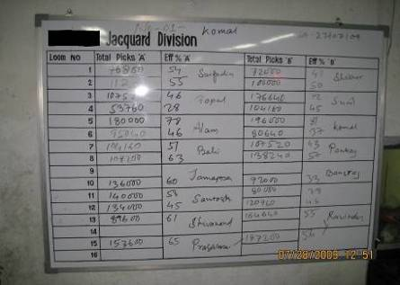
Daily performance boards have also been put up, with incentive pay for employees based on this

Slide 35
Output results in regression format
Note: standard errors boostrap clustered by firm

Slide 36
Management practices before and after treatment
Performance of the plants before and after treatment
Decentralization and IT
Why were these practices not introduced before?
36

Slide 37
Figure 6: Changes in decentralization and management practices
1=treatment plant, 0=control plant
correlation 0.594
(p-value 0.001)
Change in the decentralization index
Change in management practices

Slide 38
Figure 7: Changes in computerization and management practices
1=treatment plant, 0=control plant
correlation 0.778
(p-value 0.001)
Change in the computerization index
Change in management practices

Slide 39
Management practices before and after treatment
Performance of the plants before and after treatment
Decentralization and IT
Why were these practices not introduced before?
39

Slide 40
Why does competition not fix badly managed firms?
Bankruptcy is not (currently) a threat: at weaver wage rates of $5 a day these firms are profitable
Reallocation appears limited: Owners take all decisions as they worry about managers stealing. But owners time is constrained – they already work 72.4 hours average a week – limiting growth.
Entry is limited: Capital intensive ($13m assets average per firm), and no guarantee new entrants are any better

Slide 41
So why did these firms not improve themselves?
Collected panel data on reasons for non implementation, and main (initial) reason was a lack of information
Firms either never heard of these practices (no information)
Or, did not believe they were relevant (wrong information)
Later constraints after informational barriers overcome primarily around limited CEO time and CEO ability
41

Slide 42
Summary
Improving management practices improves productivity, leads to more decentralized decision making and greater use of IT
A primary reason for bad management appears to be lack of information, which limited competition allows to persist
Policy implications
A) Competition and FDI: free product markets and encourage foreign multinationals
B) Rule of law: improve rule of law to encourage reallocation and ownership and control separation
C) Training: improved basic training around management skills
42

